Slide 1
Be Kind
By Ermina Garini

Slide 2
BE KIND
Ann was an ordinary child living in London on the street Bracknell. She was 5 years old and she liked helping people in need.

Slide 3
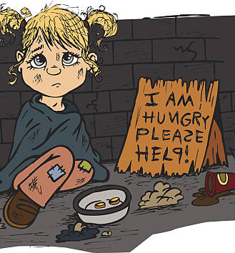
The route to school
One morning when she was going to school with her mother, she saw a homeless small girl sitting alone ion the pavement . Ann started crying ,she felt sorry for this small girl.

Slide 4
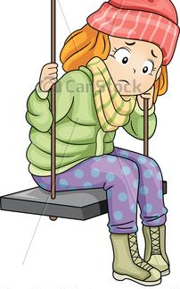
THE DAYS GO BY
Many days had passed since then. Ann was older but something was bothering her all that time .She was thinking about that young girl.

Slide 5
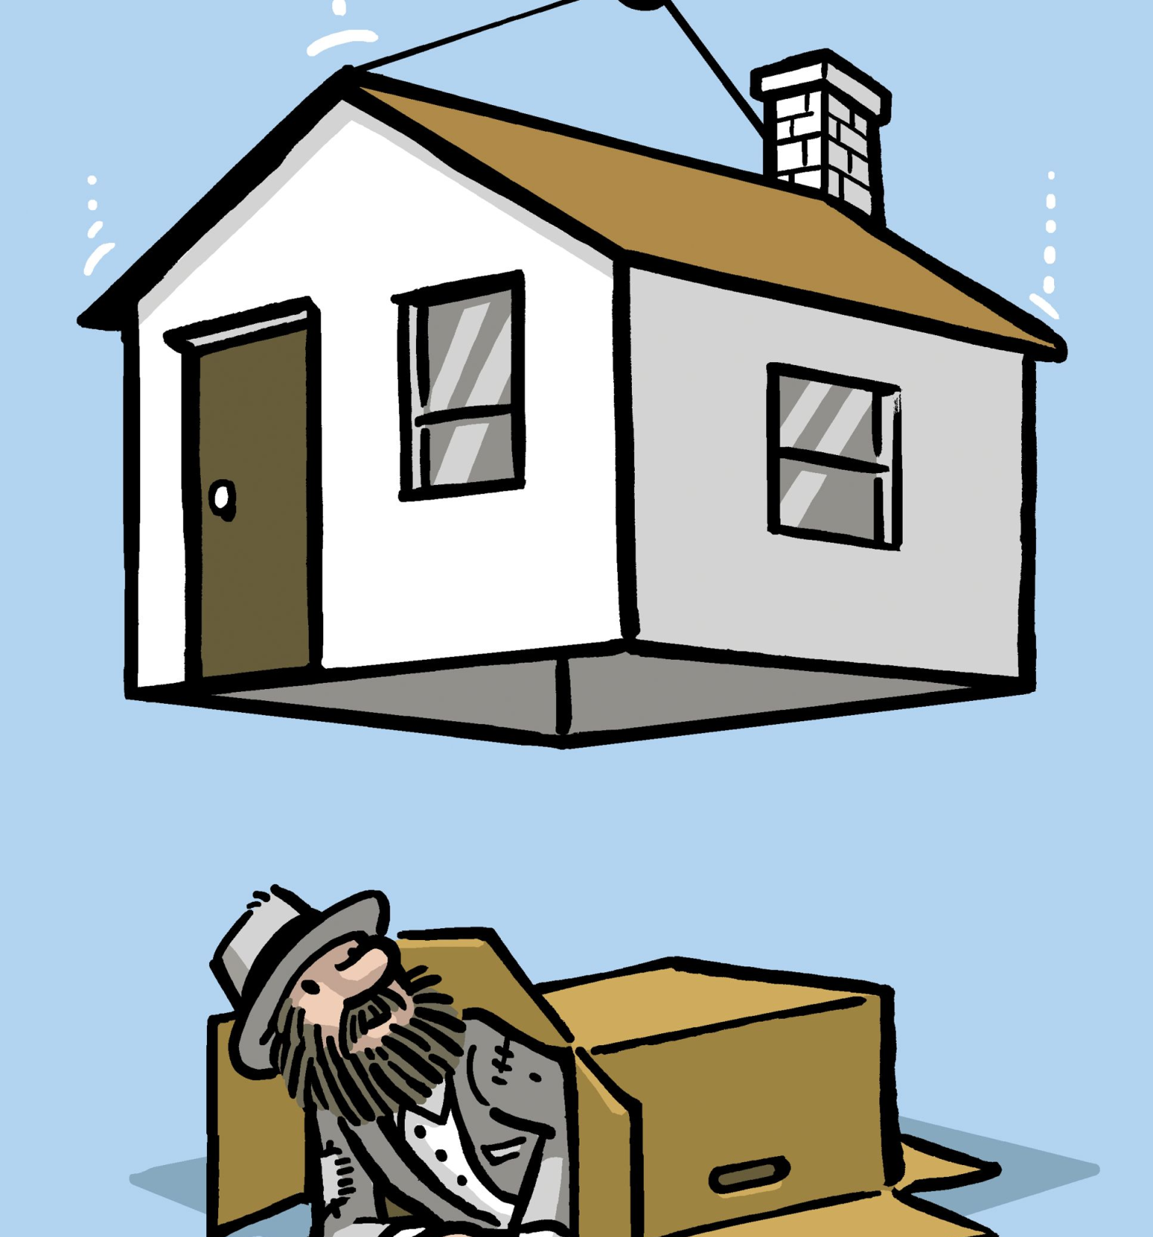
THE BIG MOMENT
So, one day when she was walking to school, she saw the homeless girl again.
She was sad and terrified. Immediately she ran to help her. When she arrived, she asked her if she wanted to stay with her. The small girl was so happy. After some minutes ,Ann said: “
Let’s go home now” And they left. The little girl now had a house to stay.

Slide 6
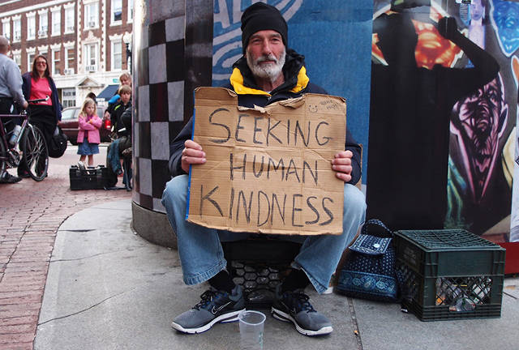
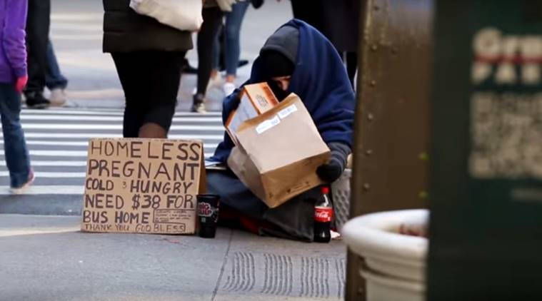
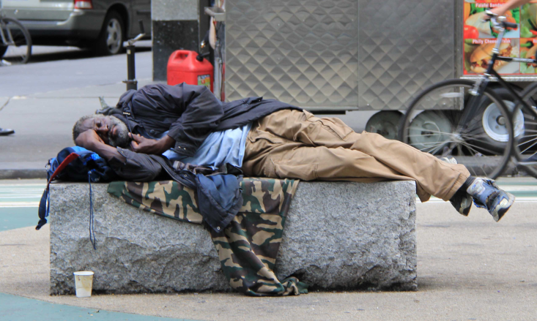
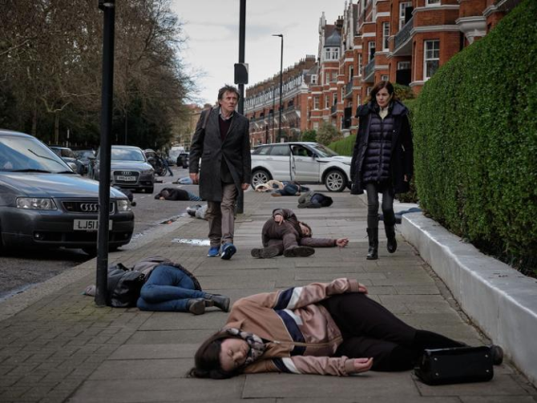
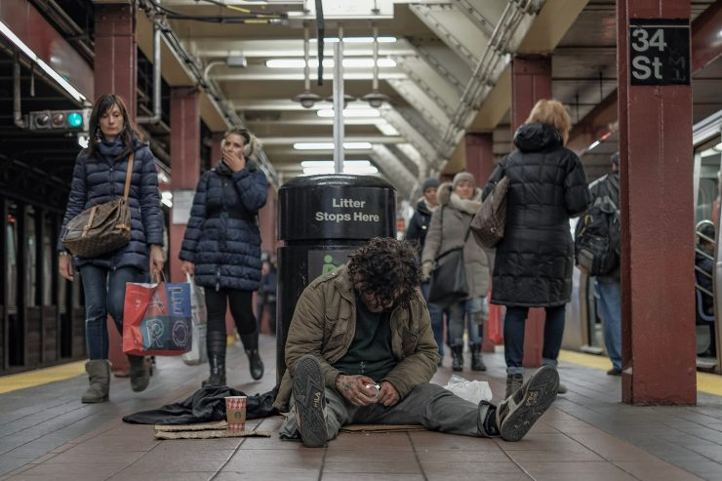
NOT EVERYBODY HAS A HOME TO STAY.

