Slide 1
LOVE IS...
GOULAS Stavros

Slide 2
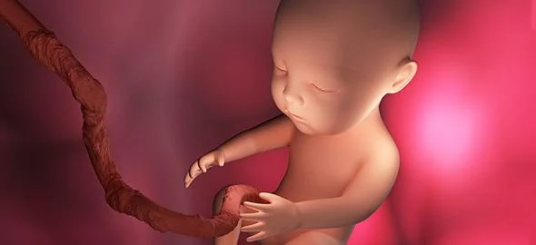
FOR ME LOVE IS…
ME INTO MY MUM’S WOMB

Slide 3
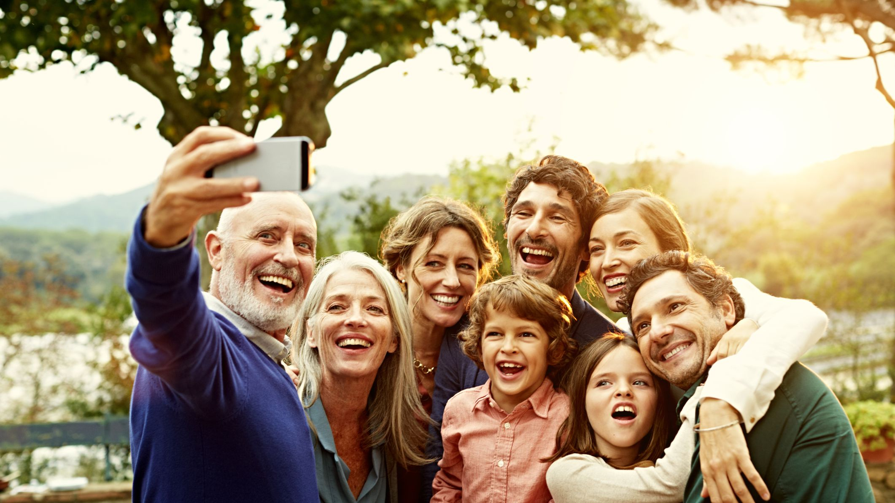
FOR ME LOVE IS…
TO BE WITH MY FAMILY

Slide 4
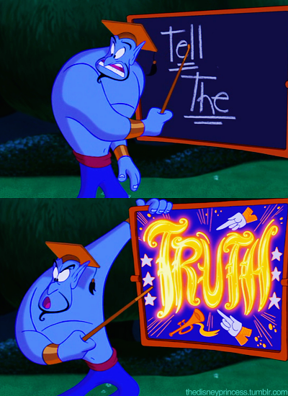
FOR ME LOVE IS…
TO TELL THE TRUTH

Slide 5
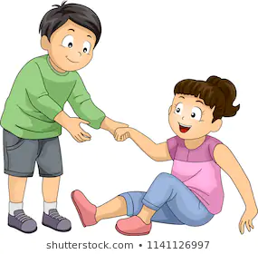
FOR ME LOVE IS…
TO HELP ONE KID WITH PROBLEMS

Slide 6
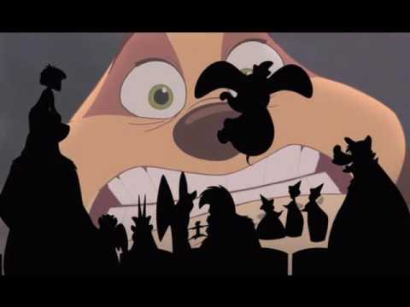
FOR ME LOVE IS…
TO WATCH A MOVIE WITH MY BEST FRIENDS EATING CRISPS

Slide 7
FOR ME LOVE IS…
WHEN MY PARENTS READ ME A BOOK BEFORE SLEEPING

