Slide 1
Love lightens your day!

Slide 2
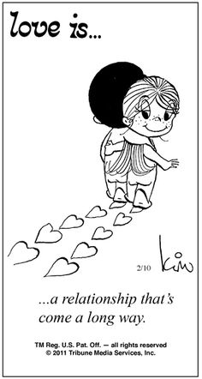
Love is a relationship that comes a long way!
Love is for ever!

Slide 3
Love is care for each other…

Slide 4
Love is care for each other

Slide 5
Love is on the air!

Slide 6
Love is on the air!

Slide 7
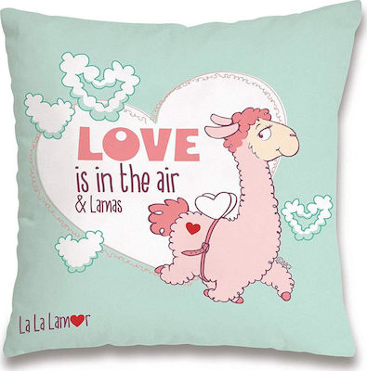
Love is on the air!

Slide 8
Love is on the air!

