Slide 1
I am love A story of Compassion
Eva Paraskevopoulou
D2

Slide 2
Love is understanding
I can know that no one is perfect

Slide 3
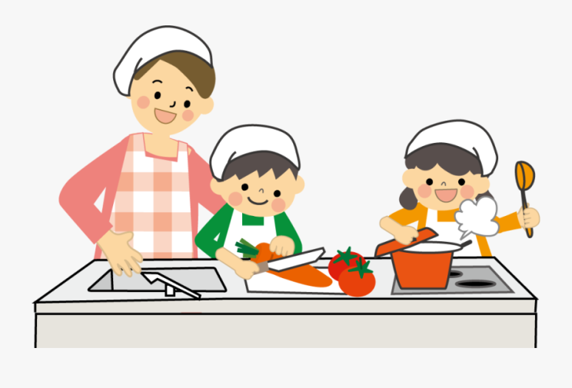
Love is creative
I can express what’s important to me

Slide 4
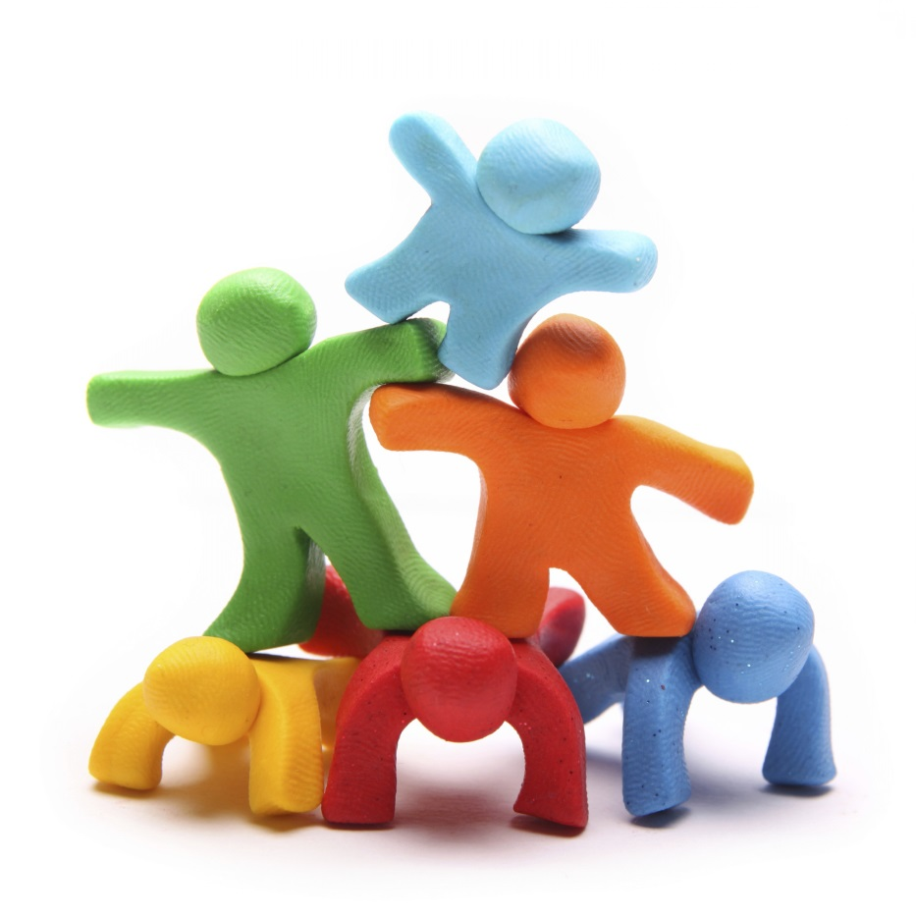
Love is effort
I can do my best to make things better when something is wrong

Slide 5
We are LOVE

