Slide 1
What is love?
Konstantinos Papakonstantinou
D2

Slide 2
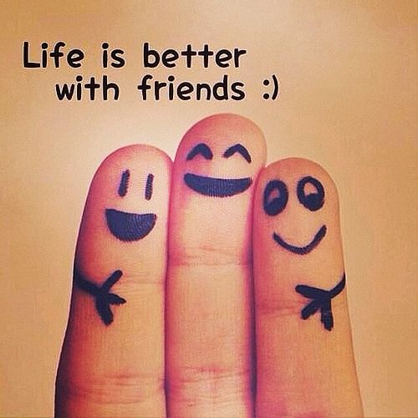
Love is friends

Slide 3
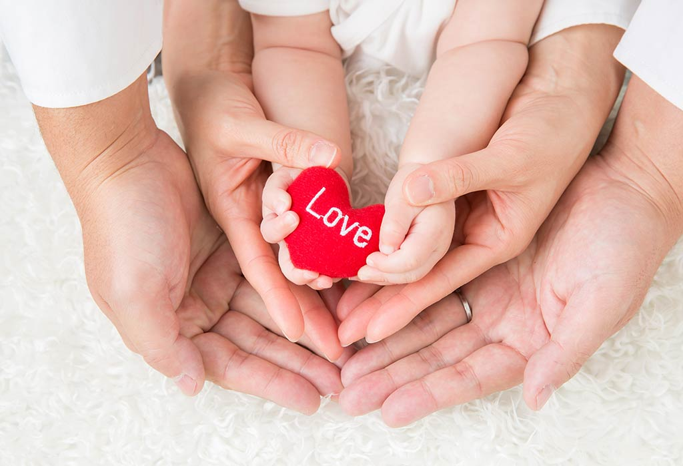
Love is family

Slide 4
Love is a rainbow

Slide 5
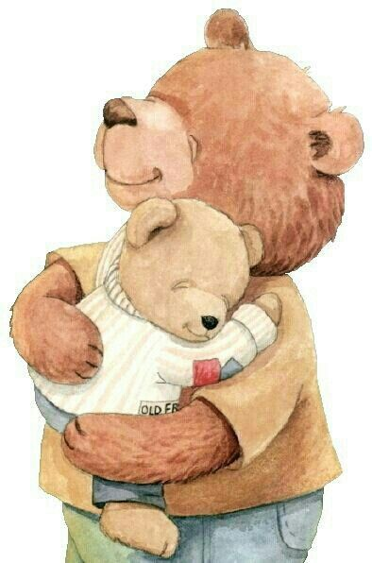
Love is a hug

Slide 6
Love is a smile

Slide 7
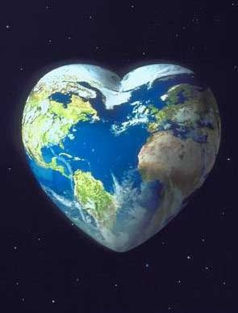
We are all love

