Slide 1
Love
Anastasia

Slide 2
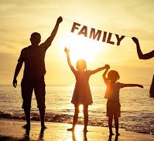
Love is...
...to have a great family

Slide 3
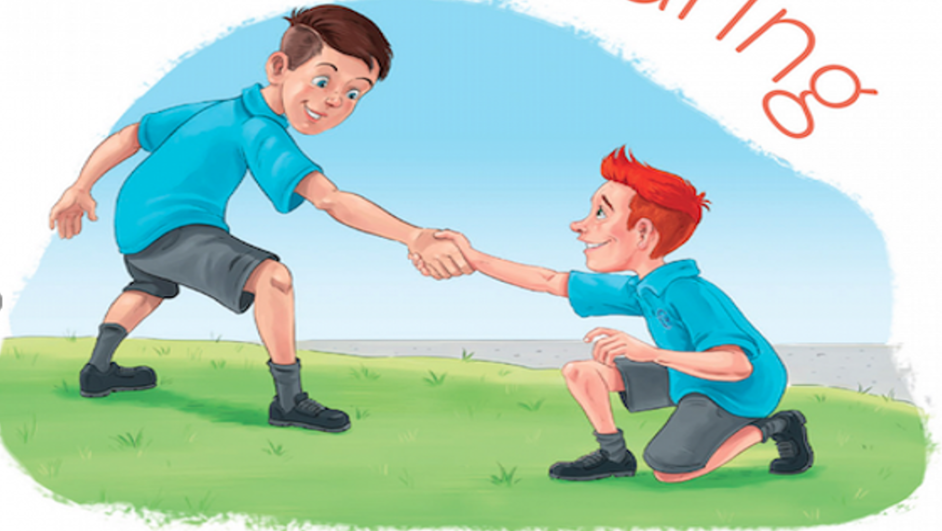
...to care for others
Love is...

Slide 4
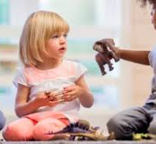
Love is...
...to share toys with other children

Slide 5
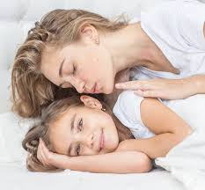
Love is...
...to wake up with a kiss from your mother

Slide 6
