Slide 1
“Be kind”
By Mariana spyrakou

Slide 2
What Does “be kind” mean to you ???
Let’s see what “be kind” is explained in this book !

Slide 3
There was was a boy named Kevin and everybody was laughing at him because he was ugly and he used to eat like a sheep.
One day, he was in the kitchen eating his lunch but he was very sad because everybody was laughing. So he went to the toilets and start crying.

Slide 4
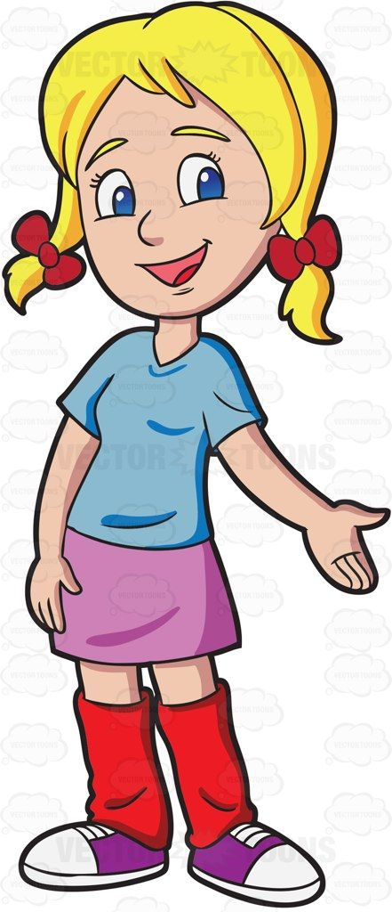
But the little girl Kendall didn’t like that. She went to the bathroom and she tried to make him feel better. That didn’t work and she was very sad with all the children’s behaviour.

Slide 5
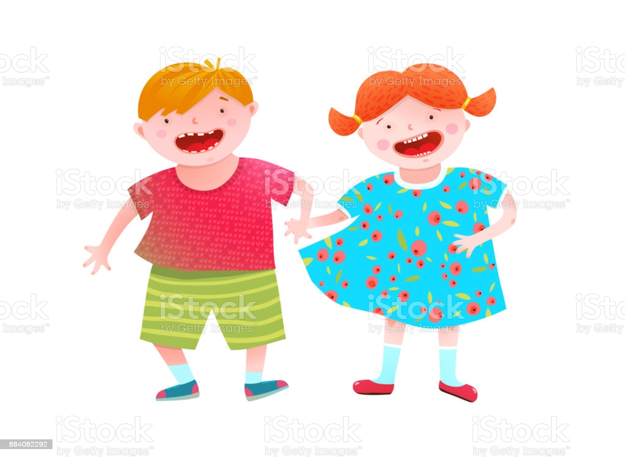
She thought that it would be a good idea to wear glasses and be ugly so that he would feel better. She went to the shop and she bought glasses.
So she went to school the other day with glasses. Everybody starting laughing at her and she understood how Kevin felt. She went to Kevin’s class and she sat near him.He felt better when he saw another kid like him. So he didn’t care about what the children said and he and Kendall became friends.

Slide 6
So everybody learned to “be kind” and that is what we have to do in our life.
If someone needs help ,we will help him
If someone needs food or water we will provide her with it
If someone needs a house, we will try to offer him a home to live.
If someone needs friends ,we can be friends with him.
And that is what Miss Evelina did with miss Antiopi Zigopoulou.

Slide 7
So everybody try to “be kind”.

Slide 8
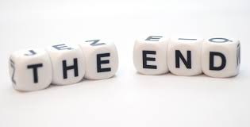
The end

