Slide 1
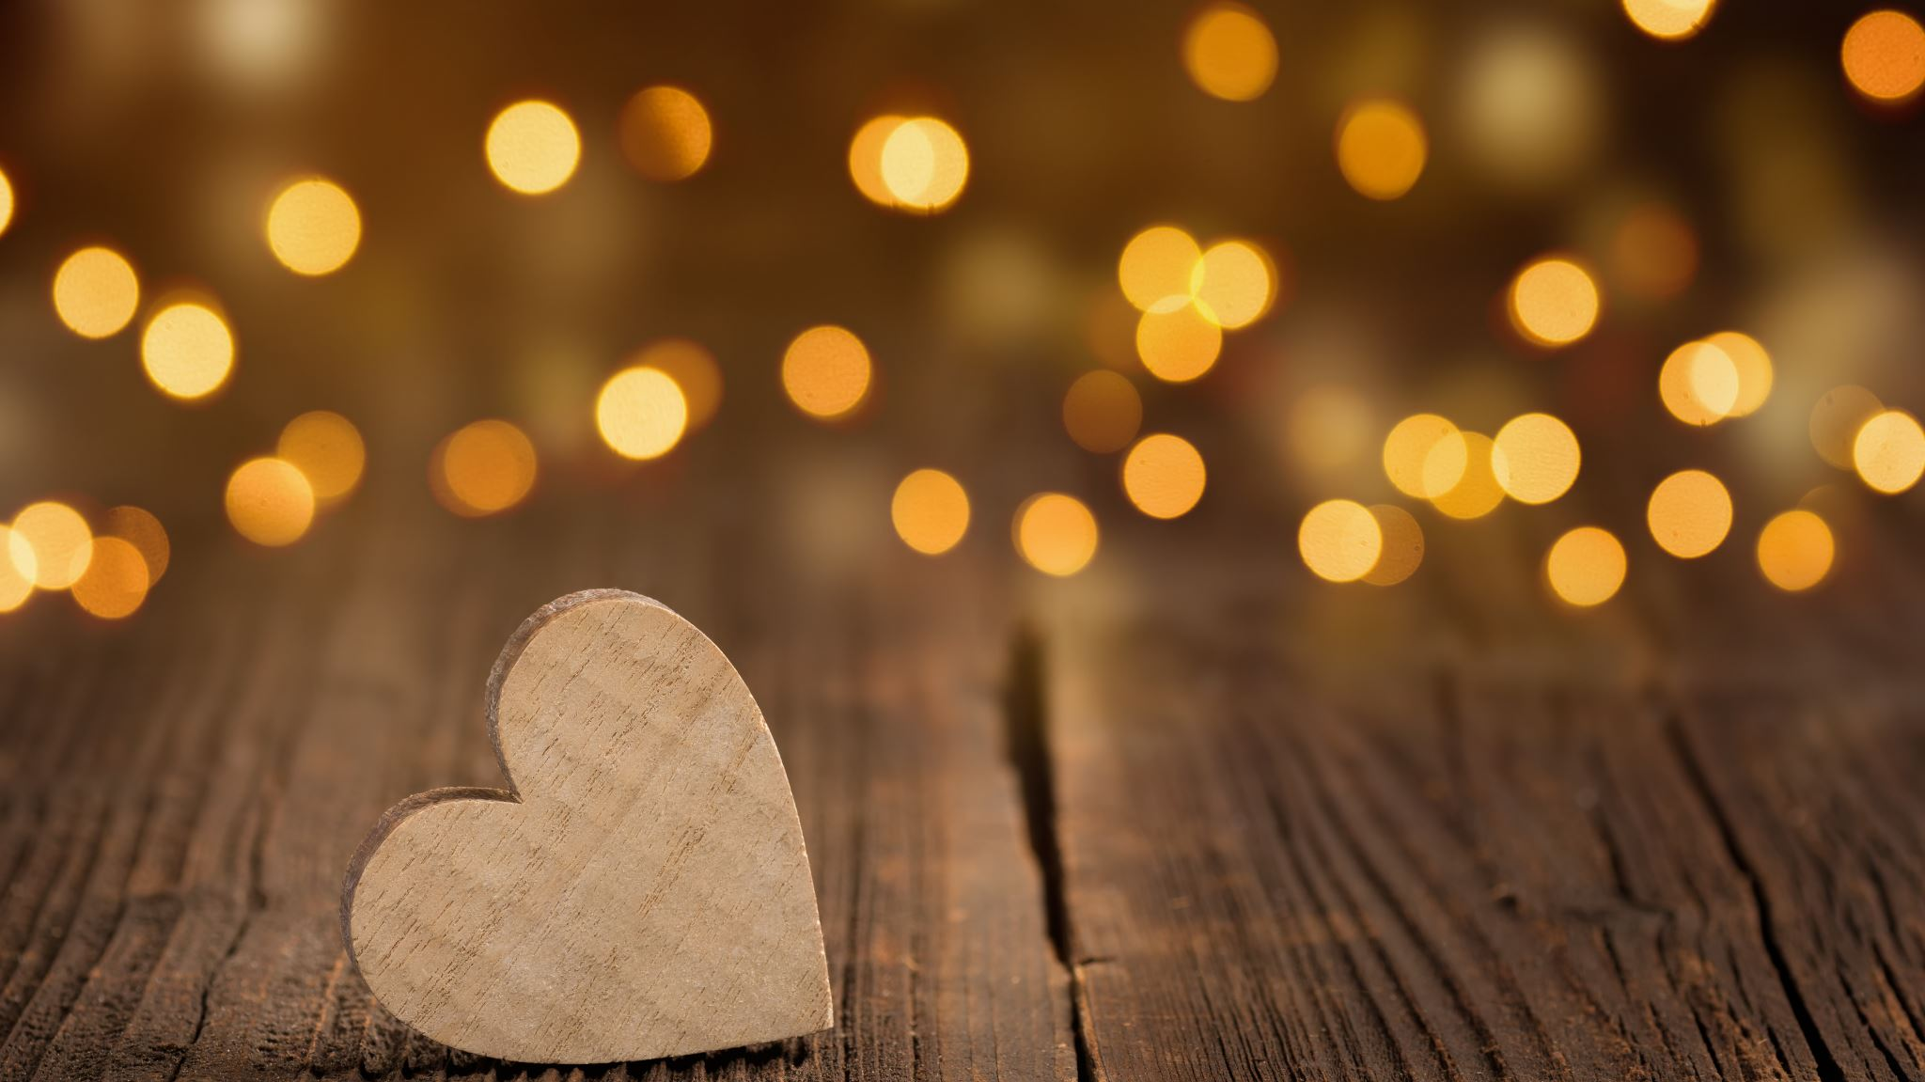
Kindness
By Andreas Anagnostou

Slide 2
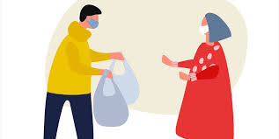
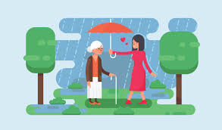
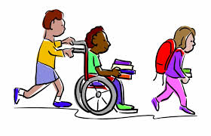
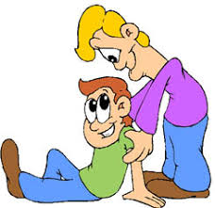
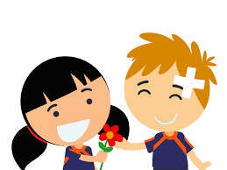
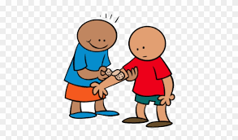
What does being kind mean to me…
It ‘s being helpful.

Slide 3
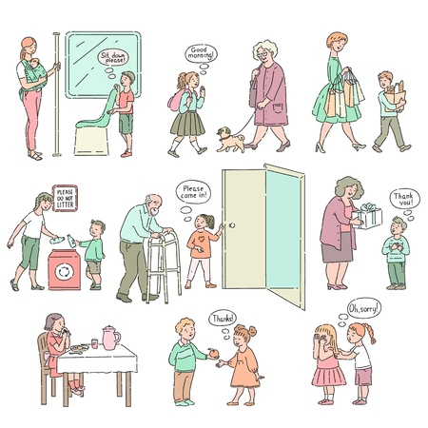
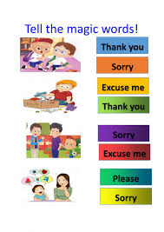
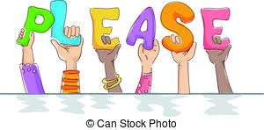
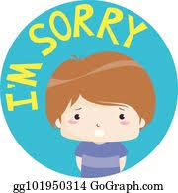
What does being kind mean to me…
It’s being polite and respectful.

Slide 4
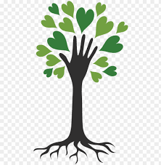
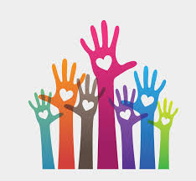
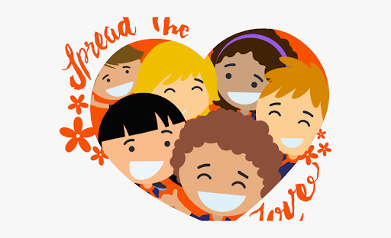
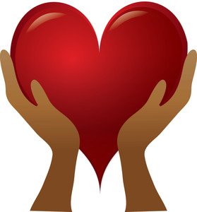
What does being kind mean to me…
It’s love in action.

Slide 5
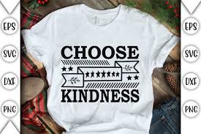
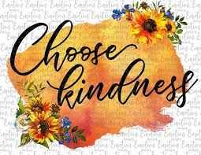
What does being kind mean to me…
It’s a choice.
Kindness is a gift everyone can give — every day — not only to others, but also to ourselves.

Slide 6
So What Is Kindness?
As you can see above, kindness is so much more than just one thing.
Kindness is many things:
Kindness is a form of love and a 6way love forms.
Kindness is a way to change the world for the better and a way to make ourselves better for the world.
Kindness is a potential path to happiness and a happy way for us to potentially find our paths.
Kindness is not just simple — it’s satisfying.
It’s not just invigorating — it’s inspiring.
It’s not just touching — it’s transforming.
Kindness isn’t just this thing or that thing.
No act of kindness
no matter how small
is ever wasted.
Aesop
Kindness Is Everything.

