Slide 1
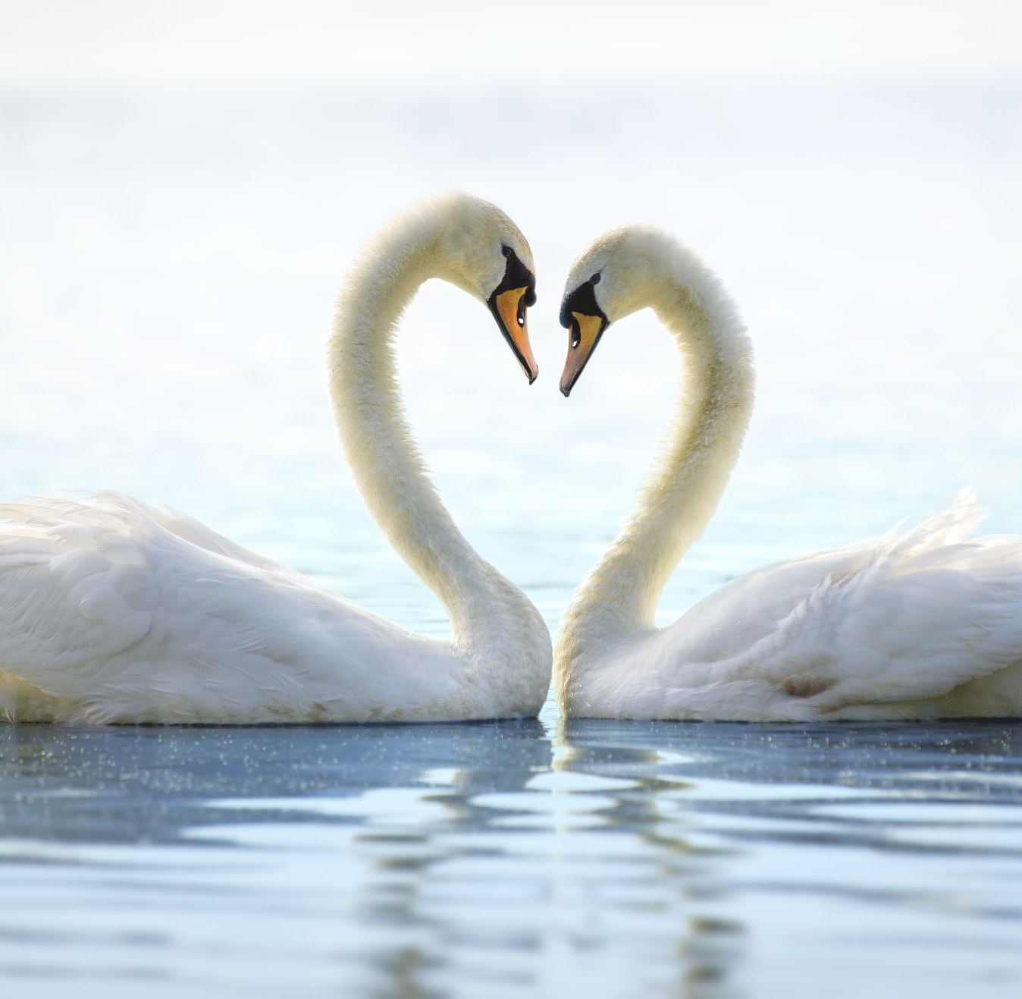
I am Love
Maria Kakiopoulou

Slide 2
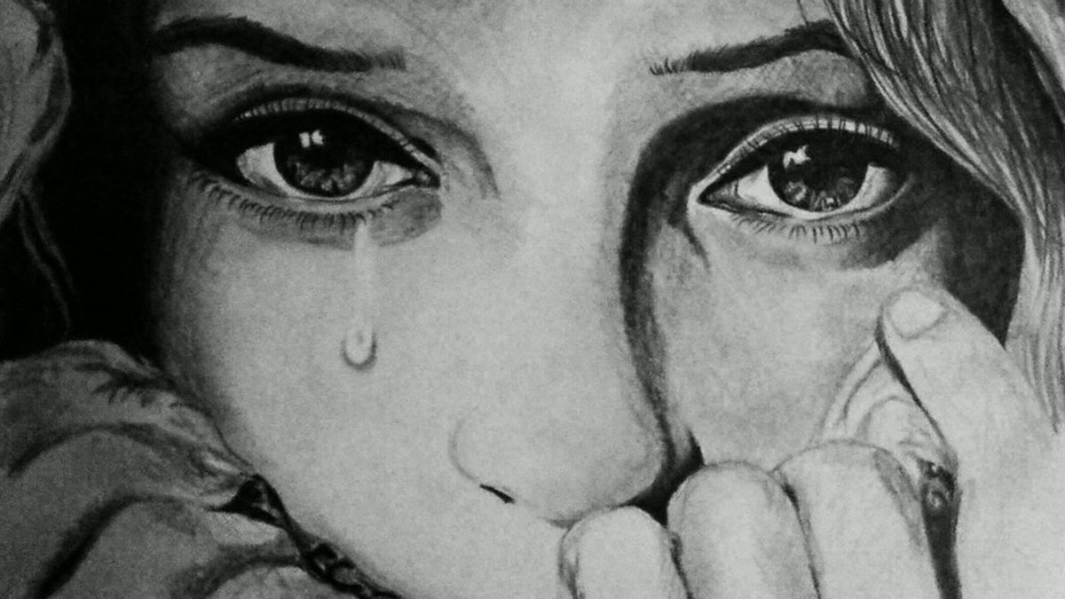
When I see someone crying

Slide 3
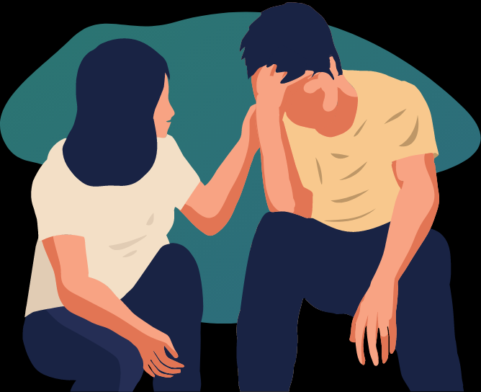
I go with her and I help her.

Slide 4
I want to be her friend.

Slide 5
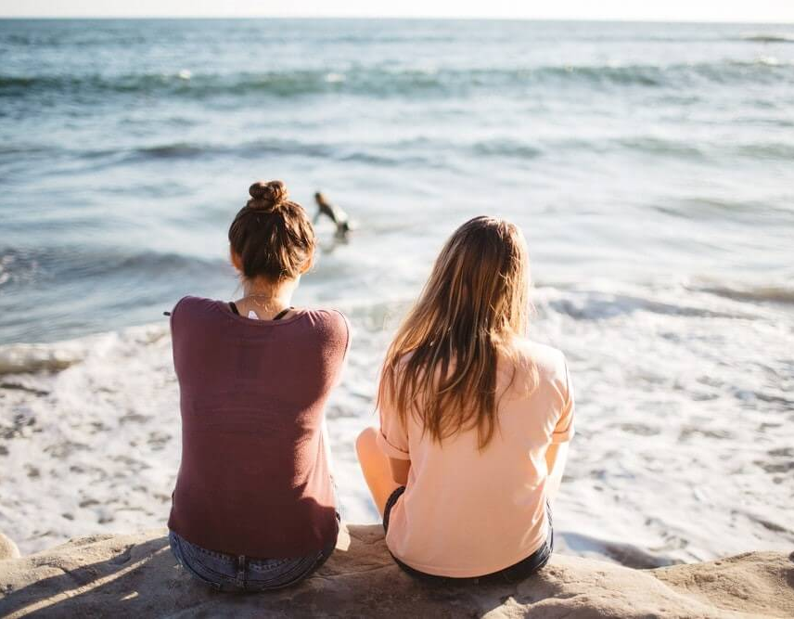
Now we are friends.

Slide 6
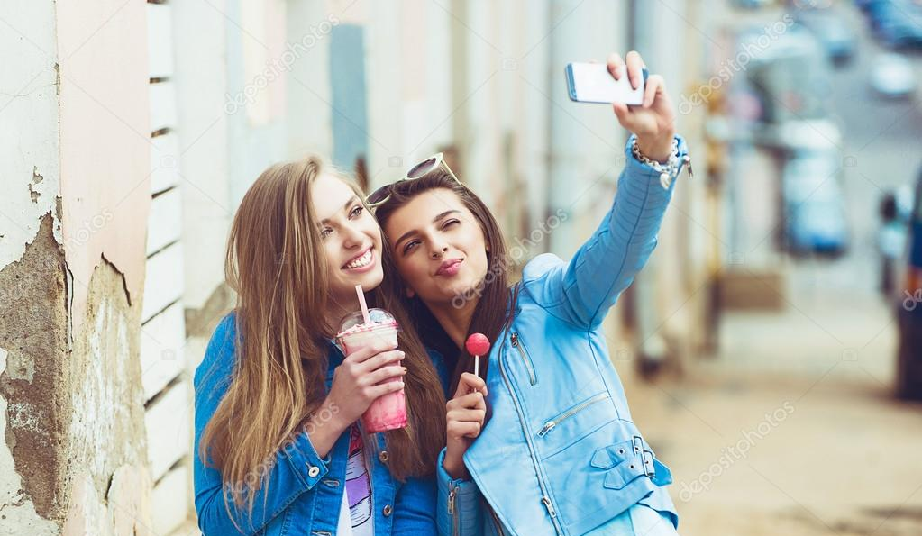
I hug her. I say <<now me and you are friends>>.

Slide 7
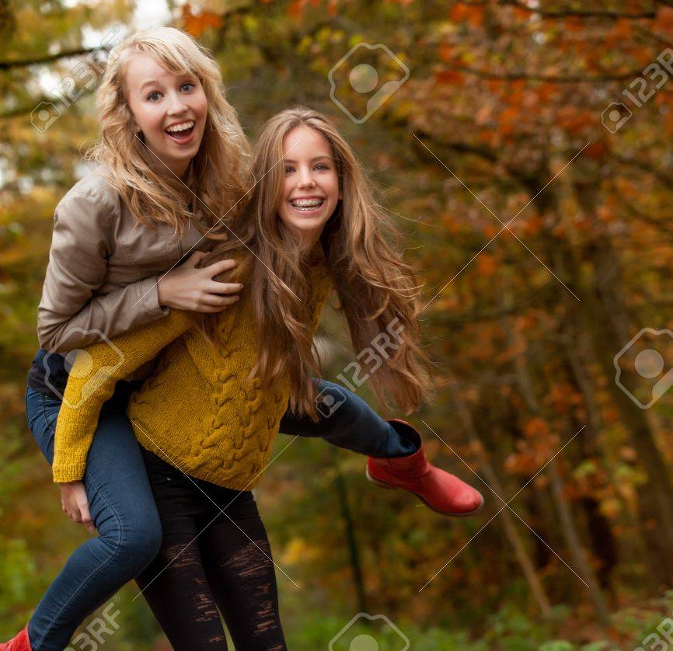
I love my friends and I help them when they are sad ….

Slide 8
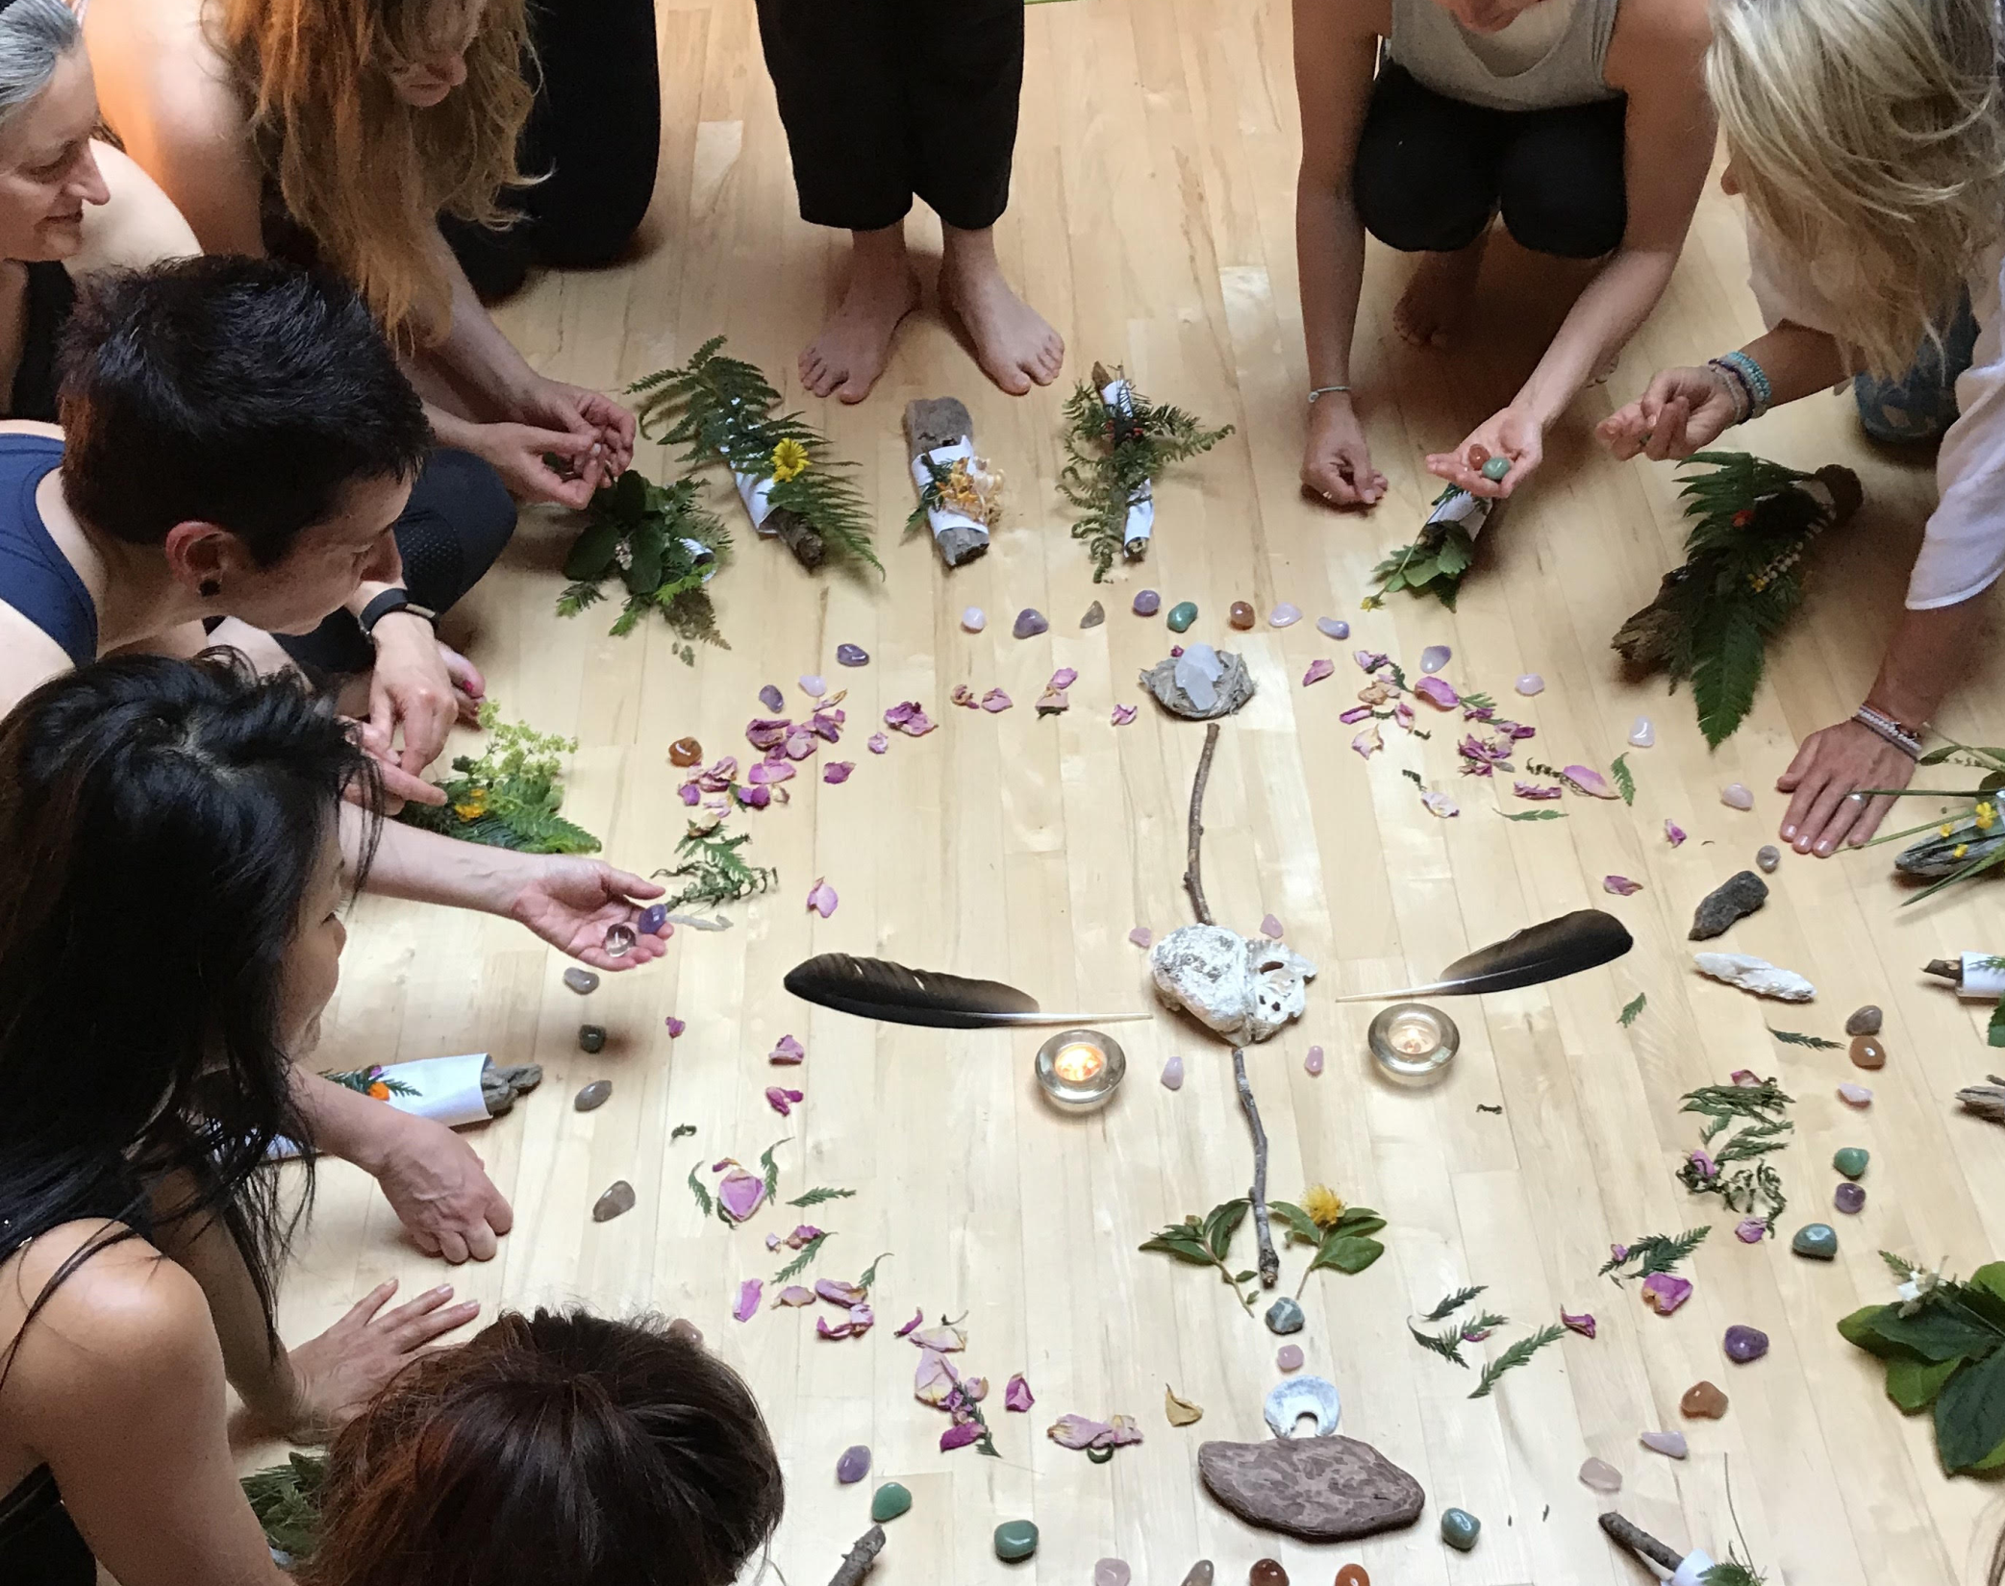
I create something with them.

Slide 9
I help them to create things

Slide 10
I help them to find things when they have lost them .

Slide 11
I want all the world to be happy.

Slide 12
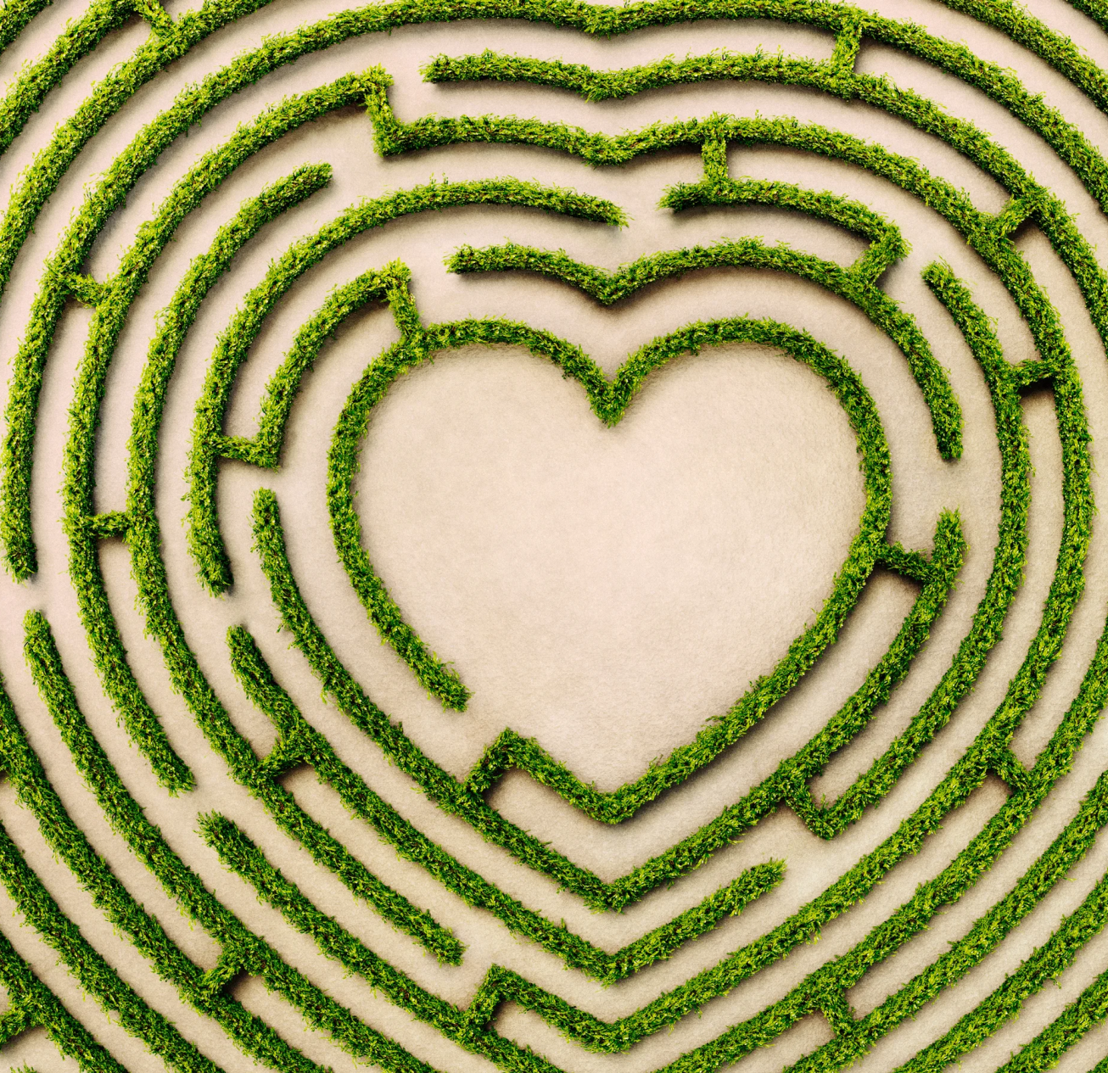
When sadness comes, I run away to find love.

Slide 13
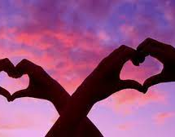
Love is everywhere.

Slide 14
Love is the best thing.

