Slide 1
❤10 Ways to be Happy❤
By Rebecca

Slide 2
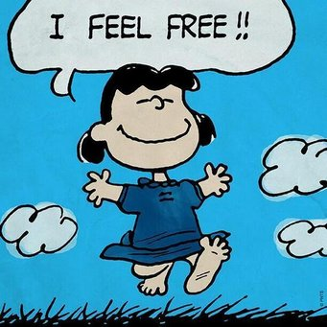
1.Feel free
Express your feelings and try to be yourself 😀

Slide 3
2.Be close to nature
When we are in nature, we feel happy and calm.

Slide 4
3.Music
Listening to music always brings positive feelings, especially when we are sad.🎵

Slide 5
4.Cuddles and kisses
Cuddling with people you love always makes you happy💋

Slide 6
5.Help others
Being kind and helpful to others, especially people in need, makes us feel better and proud of ourselves.

Slide 7
6.Memories
When we feel unhappy and things aren’t as we wish, recalling memories from good times in the past can make us feel happy.

Slide 8
7.Be Thankful for What You Have
All of us have wishes for things we don’t have for becoming something that we are not, but it is really helping us to feel grateful for what we have and for who we are.

Slide 9
8.Exercise
Doing sport and having physical action is good for our health and wellbeing.🏋🏽‍♂️

Slide 10
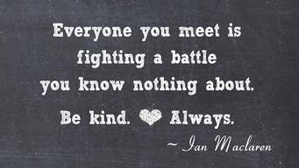
9.Treat others in a good way.
If you want others to treat you kindly, you should also do the same.💕

Slide 11
10.Enjoy the little things
Do not wait for something over-exciting to happen. Enjoy every little thing that makes you smile during your day.😁

Slide 12
Let us fill our hearts with good feelings and emotions! Merry Christmas!!!🎄🎅🏽

