Slide 1
I AM LOVE
BY LYDIA DRANDAKI

Slide 2
WHEN SOMETHING BAD HAPPENS, LIKE NOW WITH COVID,
I BELIEVE THAT LOVE WILL MAKE EVERYTHING BETTER

Slide 3
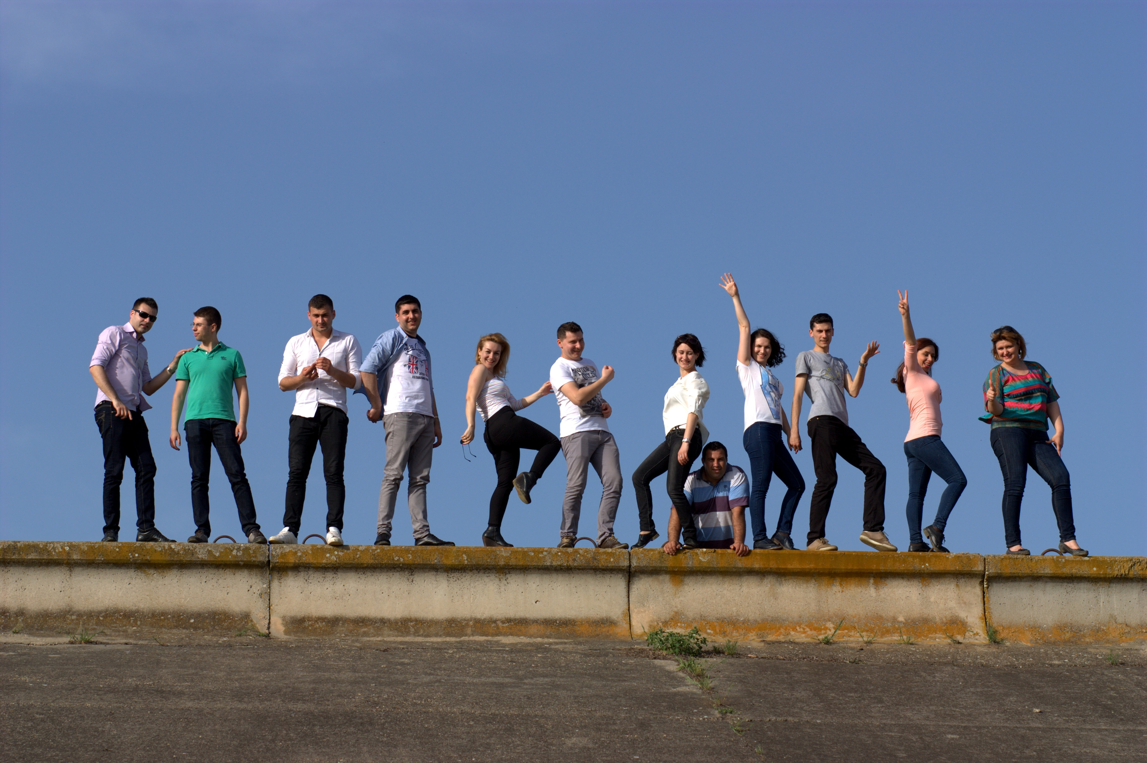
LOVE BETWEEN PEOPLE WILL HELP ME UNDERSTAND HOW
IMPORTANT IS TO PROTECT EACH OTHER.

Slide 4
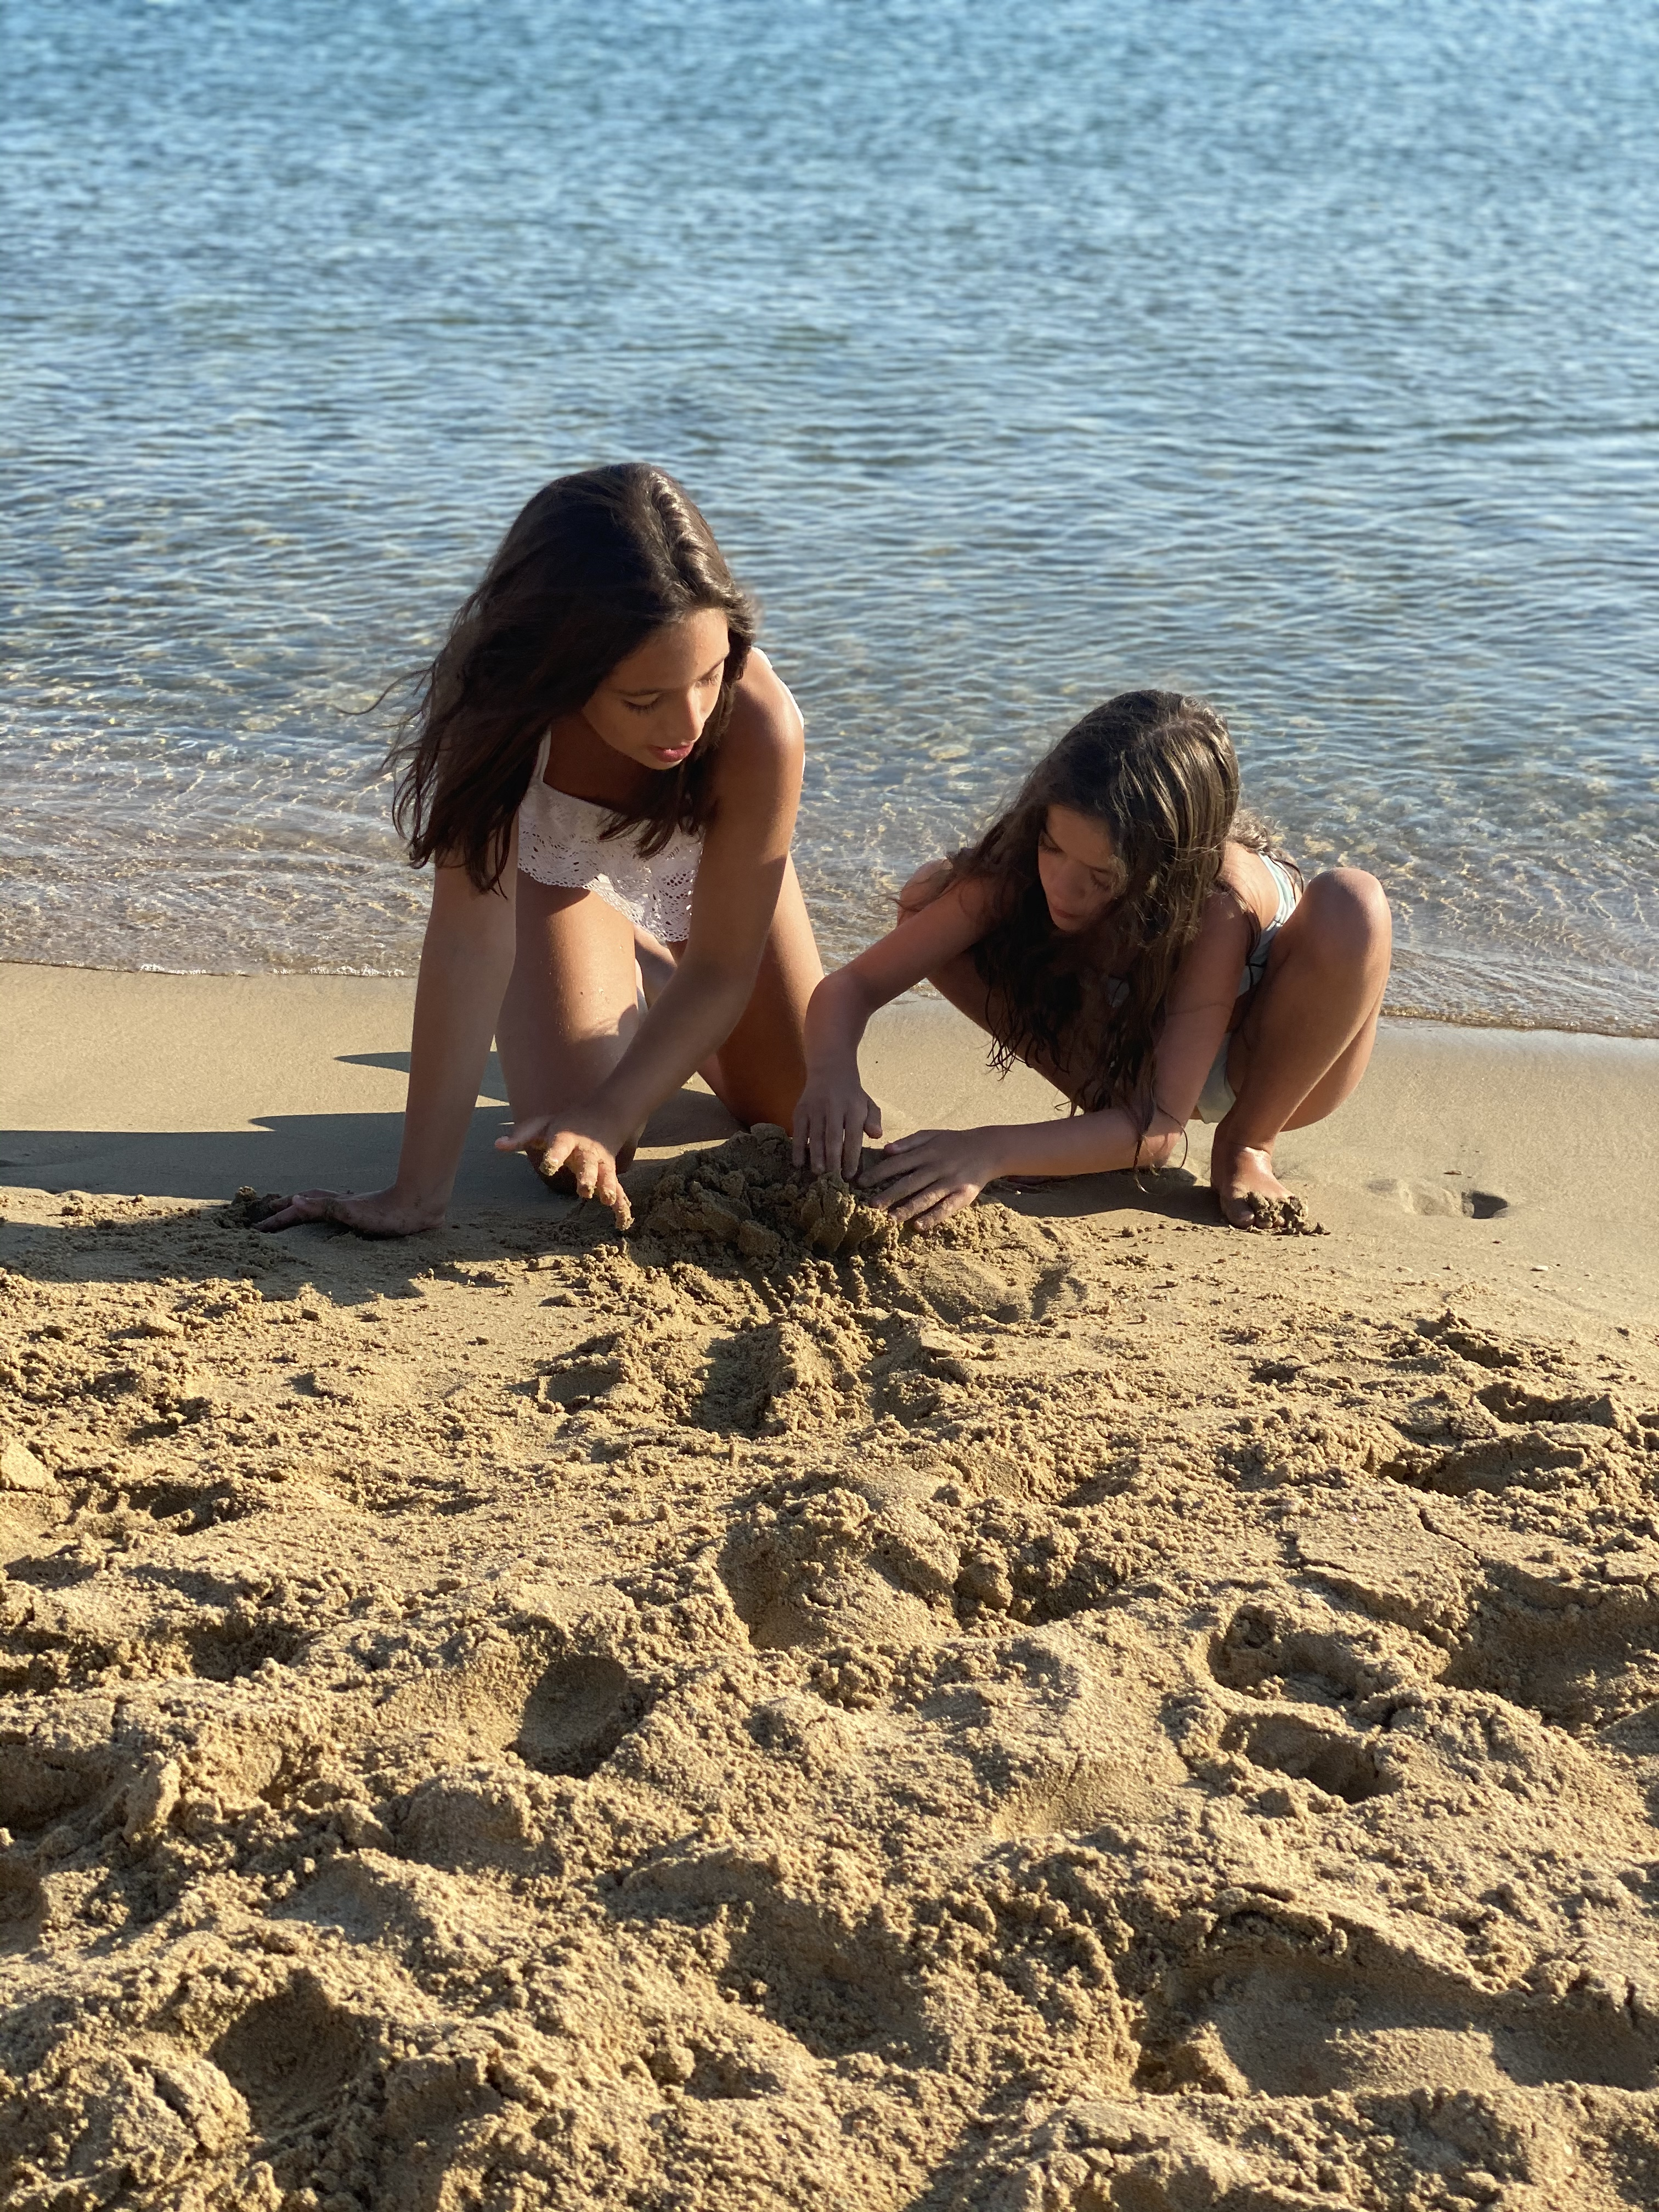
LOVE BETWEEN FRIENDS WILL MAKE ME FEEL IMPATIENT FOR ALL THE THINGS WE ARE GOING TO DO TOGETHER

Slide 5
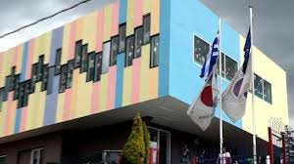
LOVE FOR MY SCHOOL WILL MAKE ME FEEL HAPPY WHEN I WILL SEE IT AND MY TEACHERS AGAIN

Slide 6
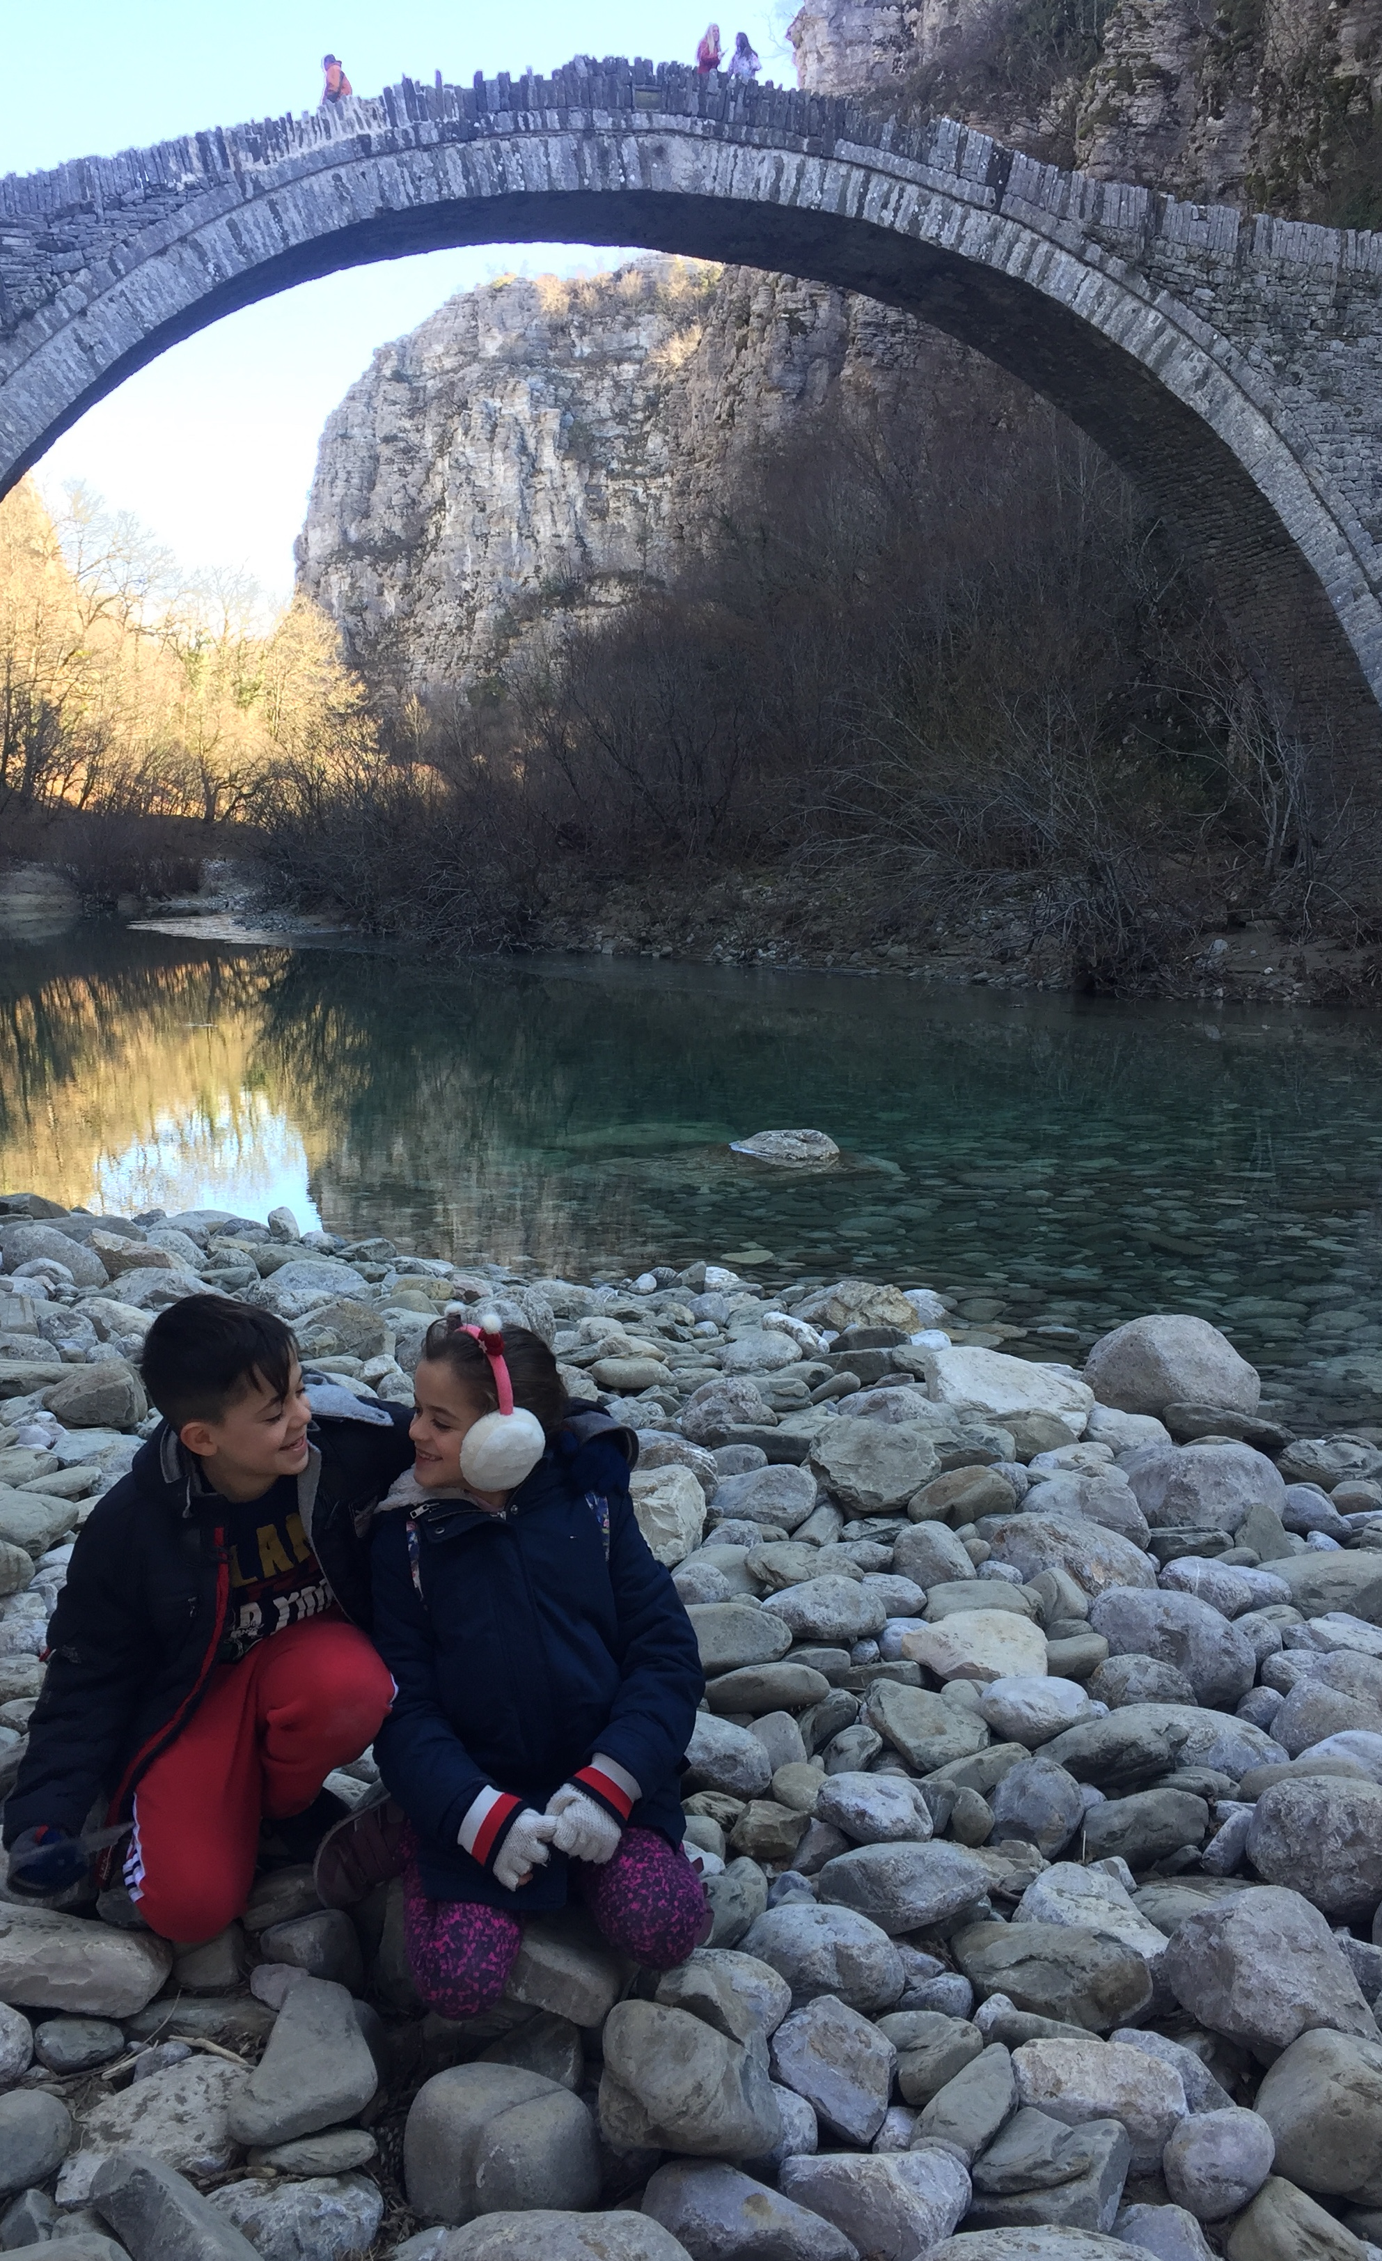
LOVE BETWEEN MY FAMILY MAKE ME FEEL HAPPY NOW THAT I STAY AT HOME

Slide 7
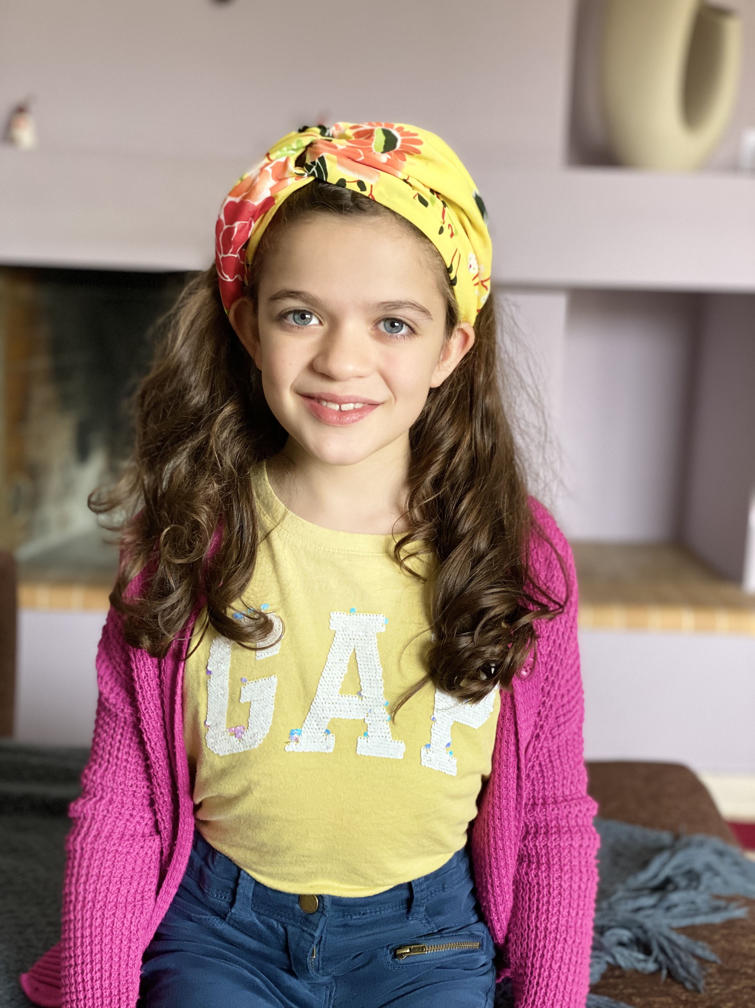
\
LOVE IS ME BECAUSE EVERYTHING I WROTE I BELIEVE THEM WITH ALL OF MY HEART.

Slide 8
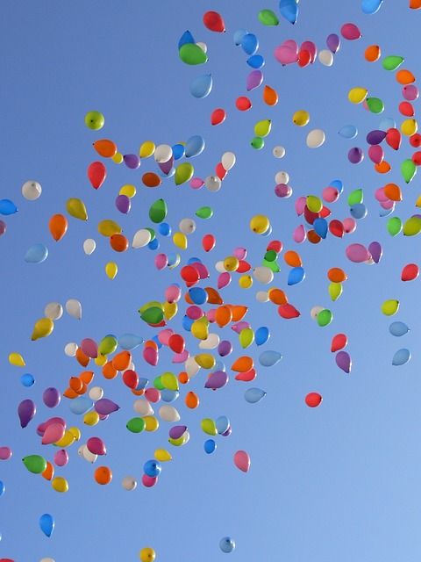
THE END.

