Slide 1
I AM LOVE !!!

Slide 2
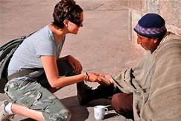
I AM LOVE. I HAVE COMPASSION.I GIVE FOOD TO POOR PEOPLE.

Slide 3
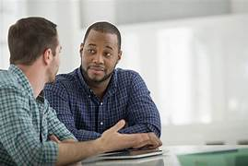
I LISTEN TO PEOPLE’S PROBLEMS

Slide 4
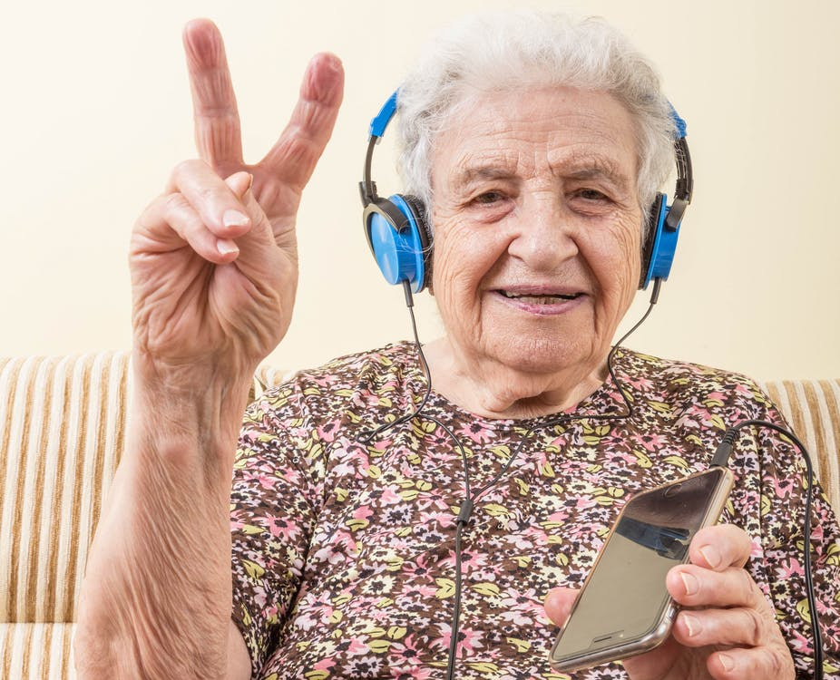
BE KIND TO OLDER PEOPLE!!! MAKE THEM SMILE!!!!

Slide 5
SAY THANK YOU!! BE POLITE!

Slide 6
SHARE A HUG WITH YOUR FRIENDS!!!

Slide 7
I AM LOVE !!! LOVE IS EVERYWHERE YOU LOOK!!

