Slide 1


Be kind
By Venelena karantzi

Slide 2


Kind heards
Kindness is one of the greatest gifts you can give to others! If someone needs help, then you can give them a “helping hand”….

Slide 3
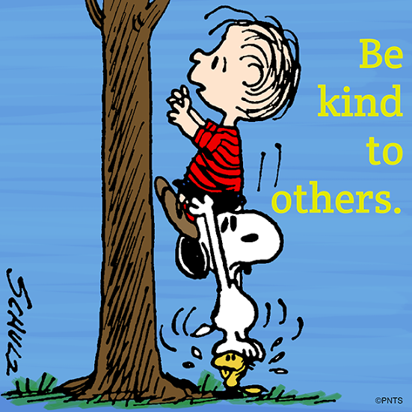
HOW MUCH DOES KINDNESS COST ???
KINDNESS COSTS NOTHING BUT MEANS EVERYTHING
Be FRIENDLY BE GOOD TO OTHERS HELP OTHERS = IT’S KINDNESS

Slide 4
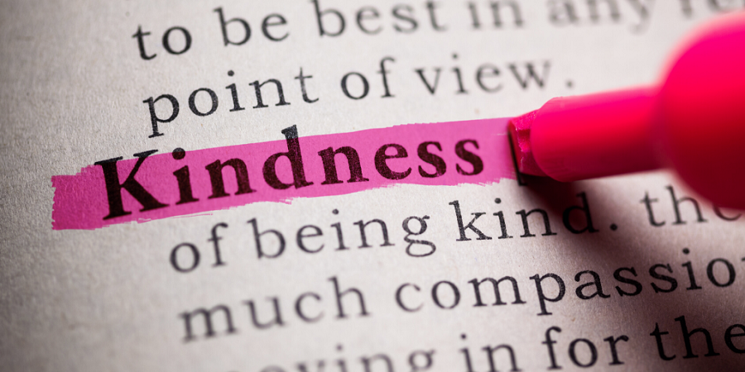
THINGS THAT SHOW KINDNESS
Support others…. Help your mum with the Housework look after someone Defend someone Say nice things

Slide 5

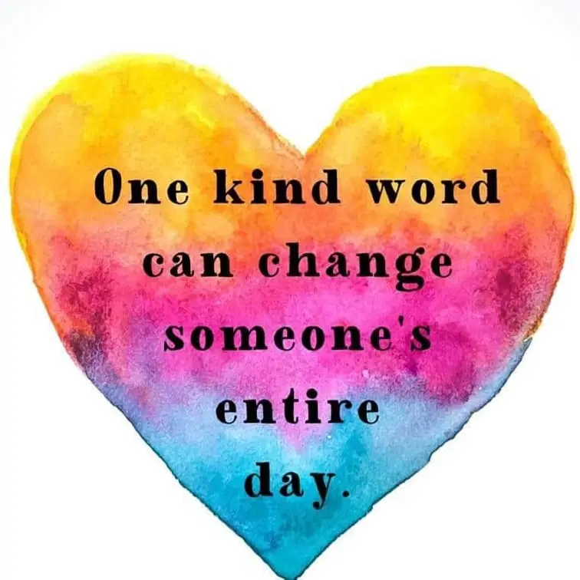
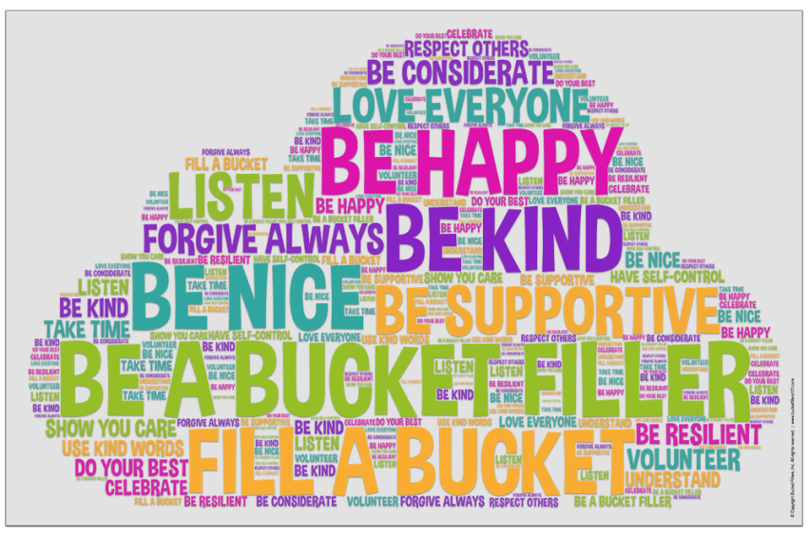
Kind words
T
hank
you
You’re welcome
I love you
good night
…
…
..
you look great
I miss you
I am
sorry
we can play
together

Slide 6

The end

