Slide 1
Being Kind
What does it mean?

Slide 2
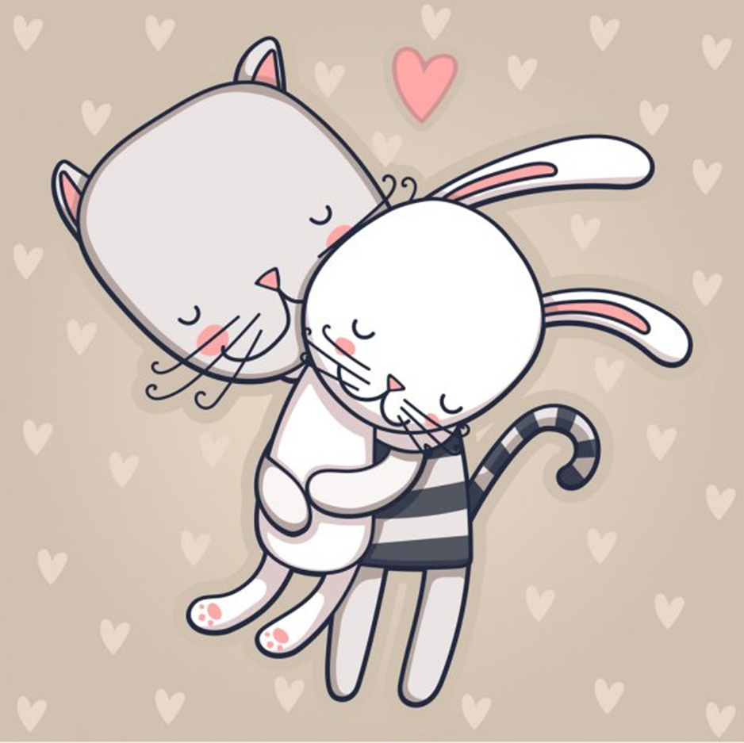
Being kind is…
To Care

Slide 3
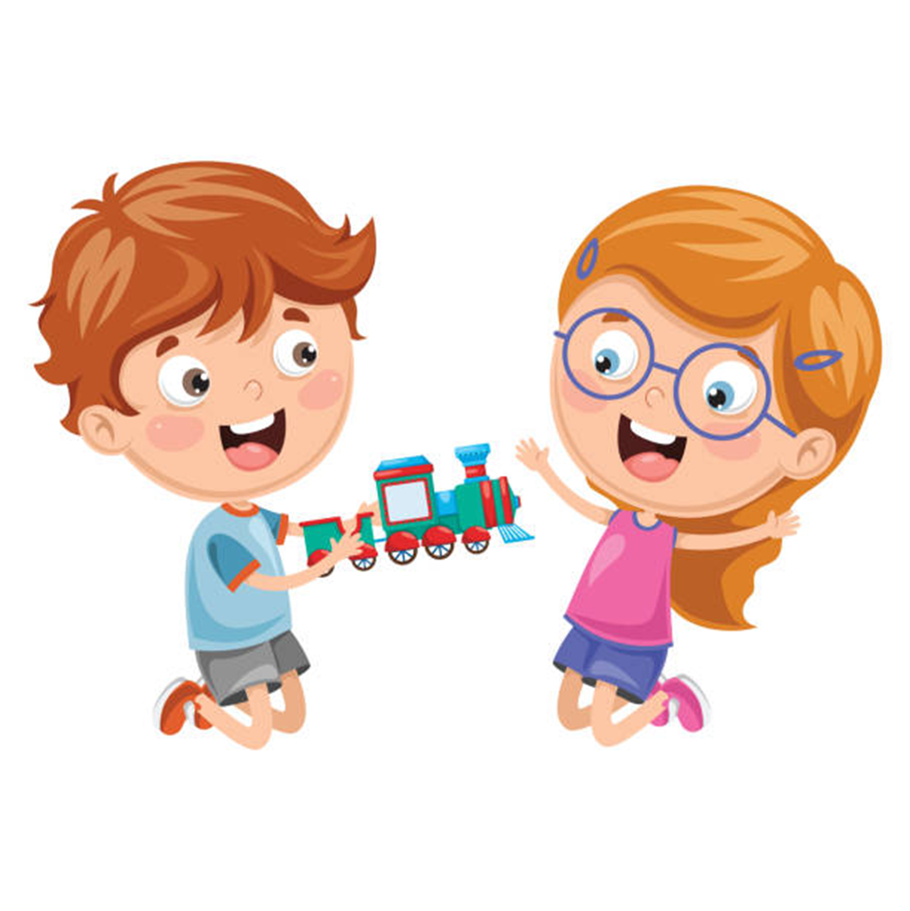
Being kind is…
To share

Slide 4
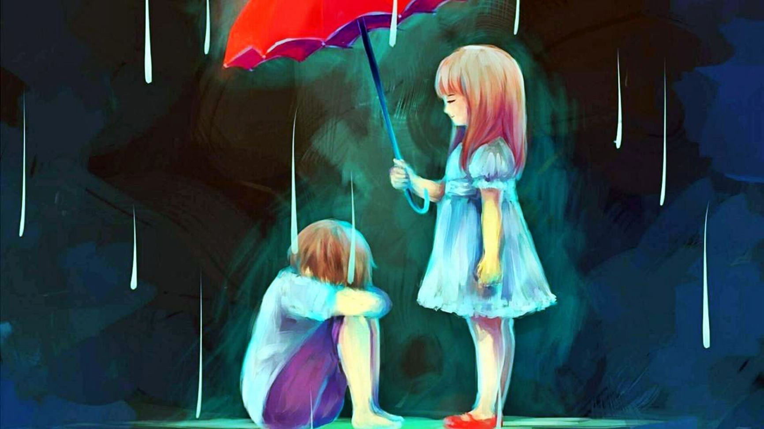
Being kind is…
To be there

Slide 5
Always try to be kind – you never know what the other person is going through

