Slide 1
Be Kind
By
Lydia Phylactopoulou

Slide 2
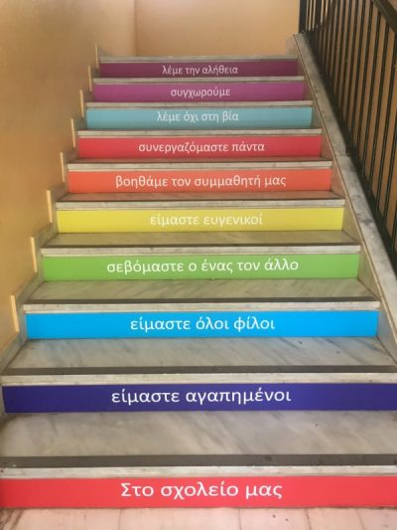
What being kind means to me
Be kind to me means, a lot of things.
Some of these are:
Be caring,
Be sharing,
Be considerate,
Be generous,
Be helpful,
Be polite…

Slide 3
Examples
Let me tell you some examples of what being kind means to me :
Saying nice things to someone
Sticking up for someone when others are not kind to him
Paying attention when someone tells you something
Be generous to your family and your friends
Help people in need
Caring for older people
Caring about the Earth
Make people happy
Keep company to someone
Saying thank you

Slide 4
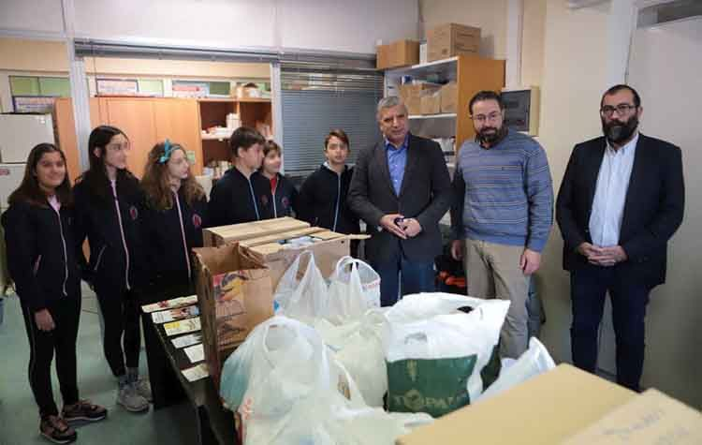
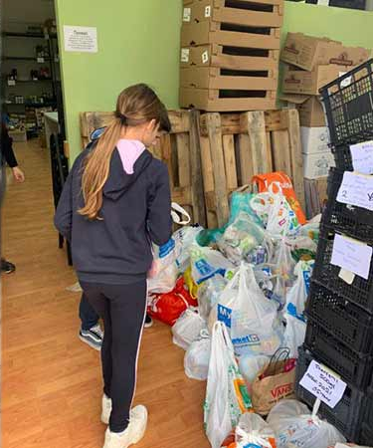
Who helps me learn how to be kind
In my everyday life my family, teachers and school help me to understand and learn how to be kind.
In my school we do many things that helps me understand what being kind means:
We gather food, clothes and medicine which we give to people in need, homeless people, children without a family and elder people. The last time we did that, was after the earthquake in Samos.

Slide 5
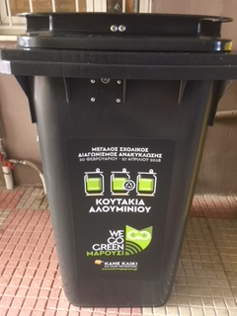
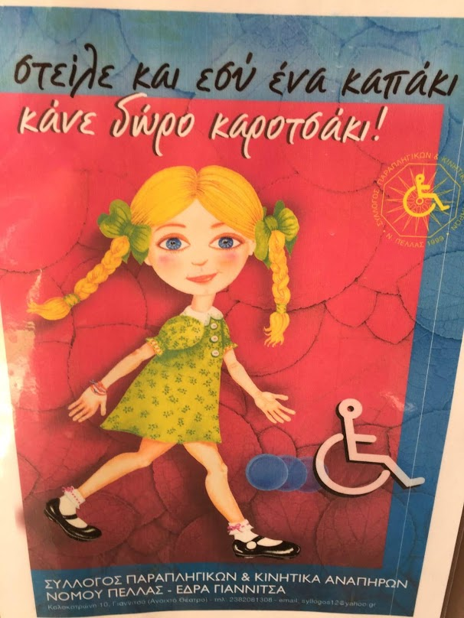
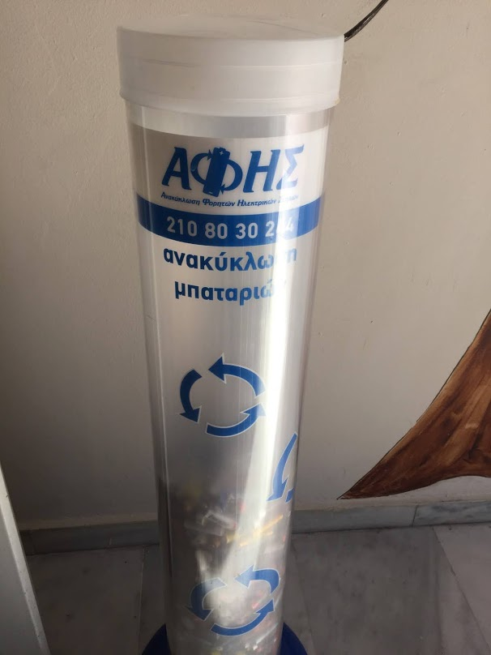
Who helps me learn how to be kind
Also we care about the environment and the earth. We do that every day by recycling paper in special garbage bins and by not littering the play ground and the classrooms.

Slide 6
Who helps me learn how to be kind
My family helps me understand how to be kind in many ways such as:
Doing my chores
Keeping company to my grandparents
Giving the clothes I don’t wear anymore to other people who need them
To say thank you
Not making fun of other people
Being polite

Slide 7
Thank you💗
THE END 💙❤✨

Slide 8
Thank you💗
THE END 💙❤✨

