Slide 1
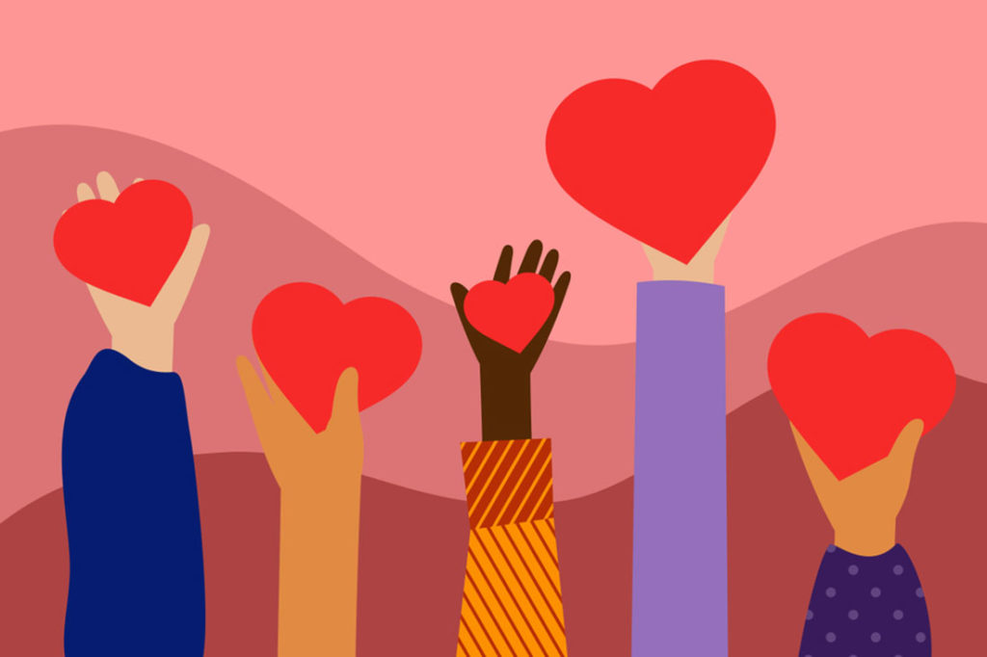
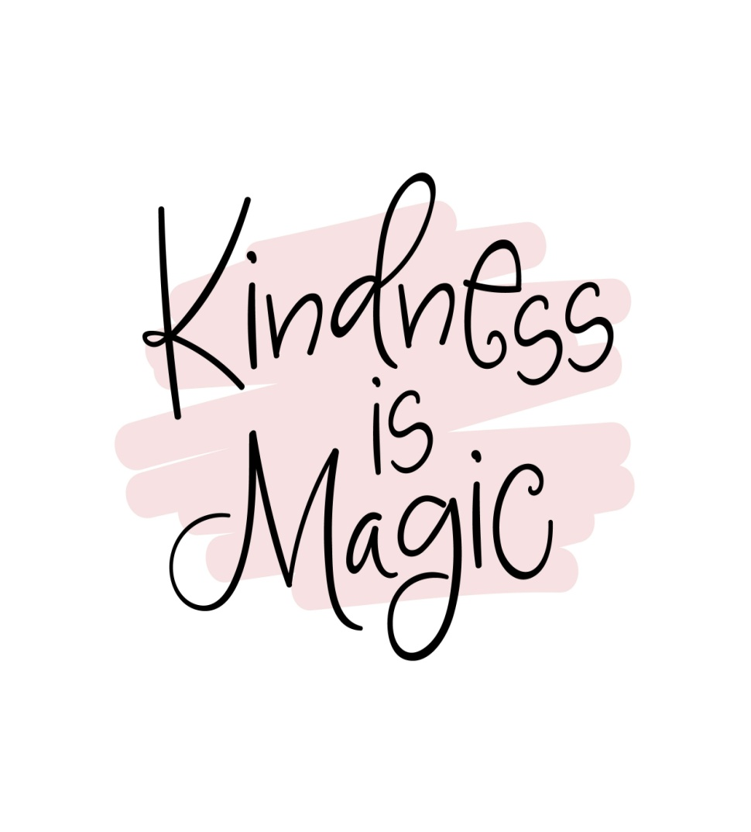
BE KIND What does being kind mean to you?

Slide 2
Be kind means:
You are most concerned what is right
Interested in being kind

Slide 3
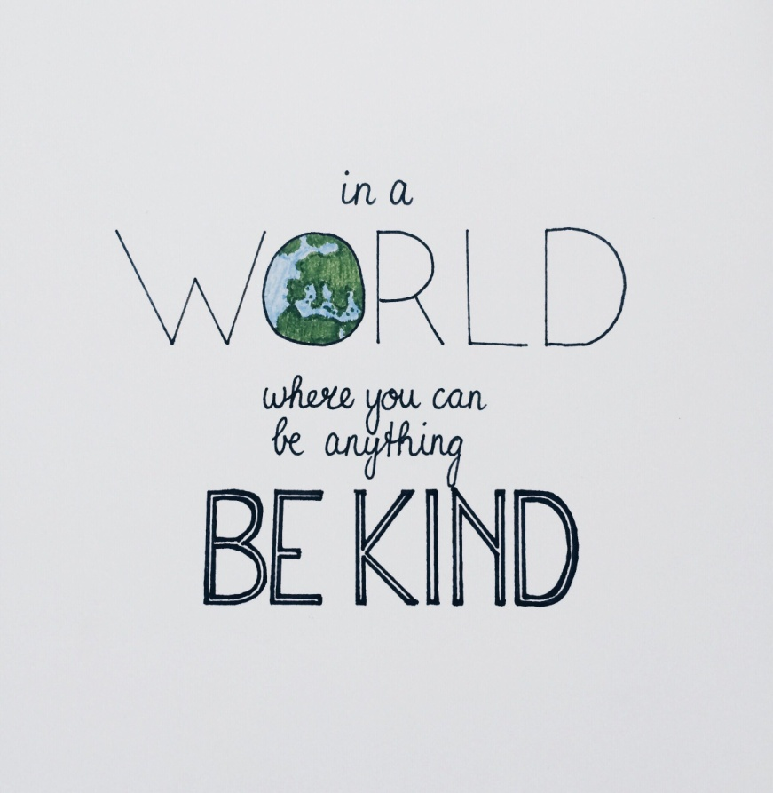
REMEMBER TO :
Help someone who needs it
Share things with your friends/siblings

Slide 4
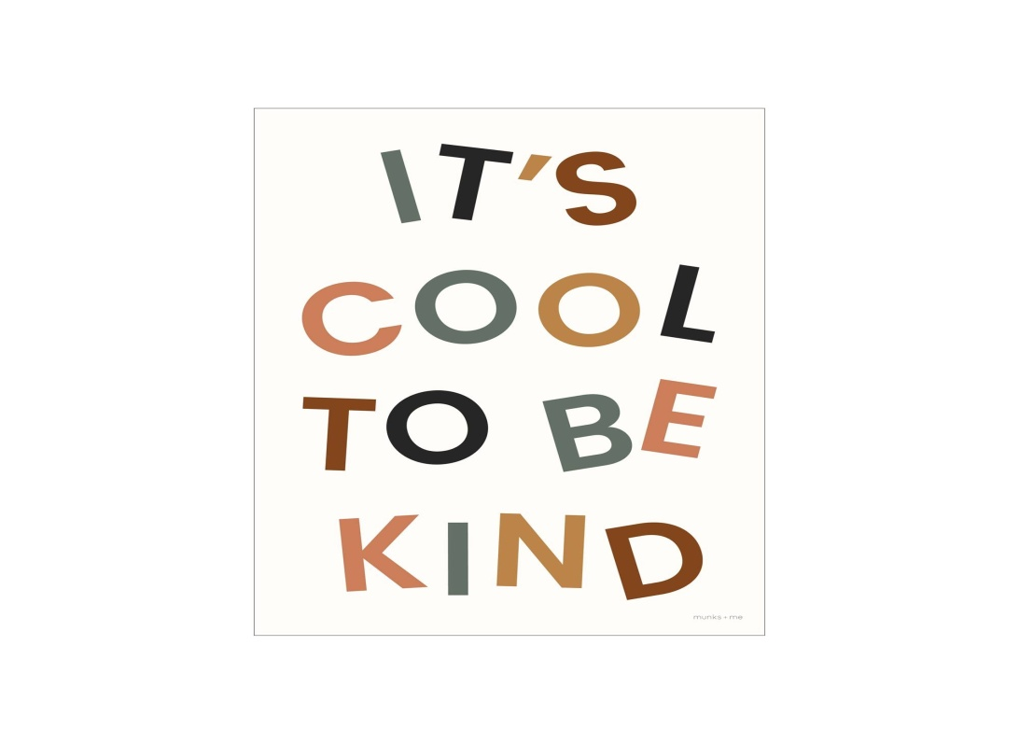
Don’t forget to :
Help your mum with chores
Pay attention to someone talking to you

Slide 5
Say:
Thank you!
Bless you !
Hello !
Goodbye !
Goodnight !
Goodmorning !

Slide 6
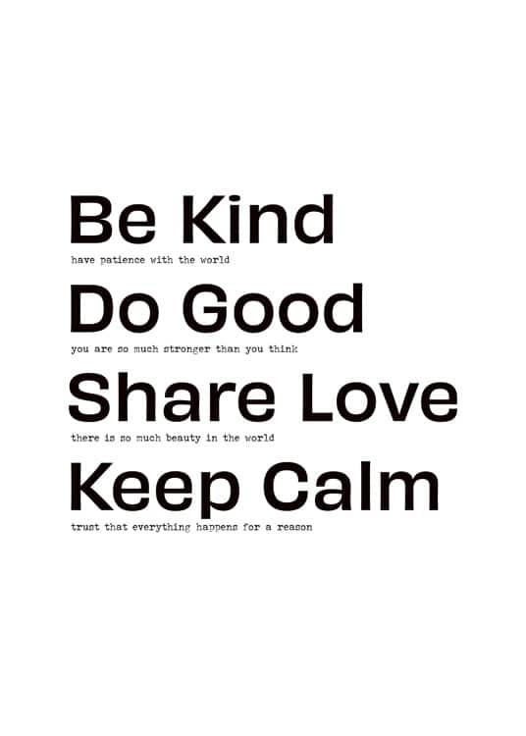
To:
Forget someone’s mistakes
Offer your help

Slide 7
Maybe:
make a compliment if you feel it …
write a kind letter to someone

Slide 8
That’s my opinion about what kind means!
From: Marilia Sfyraki

