Slide 1
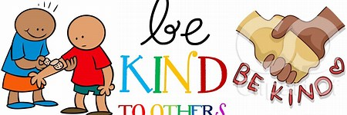
BE KIND
By Andreas Giannopoulos

Slide 2
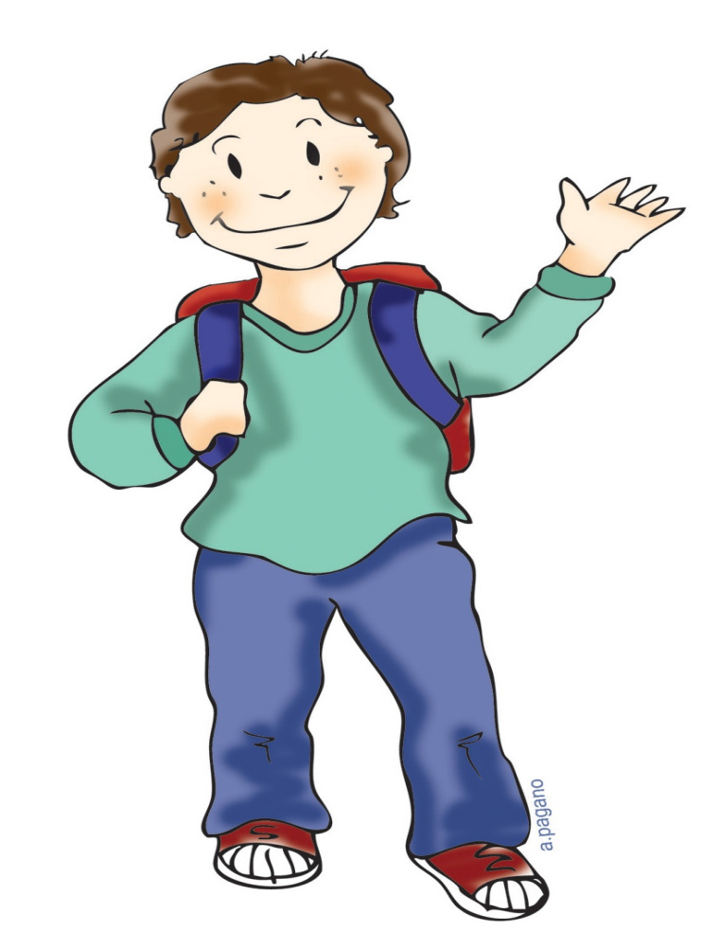
One day a new boy arrived at my school

Slide 3
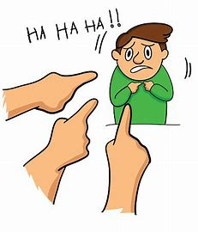
No one was talking to him and everyone was making fun at him

Slide 4
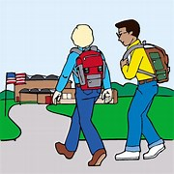
I didn’t understand why the other children didn’t welcome him so, I decided to show him the school

Slide 5
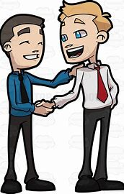
When I finished showing him the school he asked what his name was . I told him I was named Andrew and I asked him what his name was . He told me he was named Mark. Since then, we became really good friends.

Slide 6
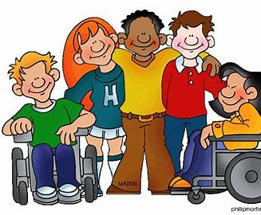
That’s why it is really important to be kind. If everyone is kind the world is a better place.

Slide 7
THE END

