Slide 1
BE KIND!
By Lida Ioannidou!

Slide 2
Ellie woke up in the morning and thought of her mum’s words “BE KIND”. So she run into the kitchen and said to her mum “You are so beautiful today,Mum!”

Slide 3
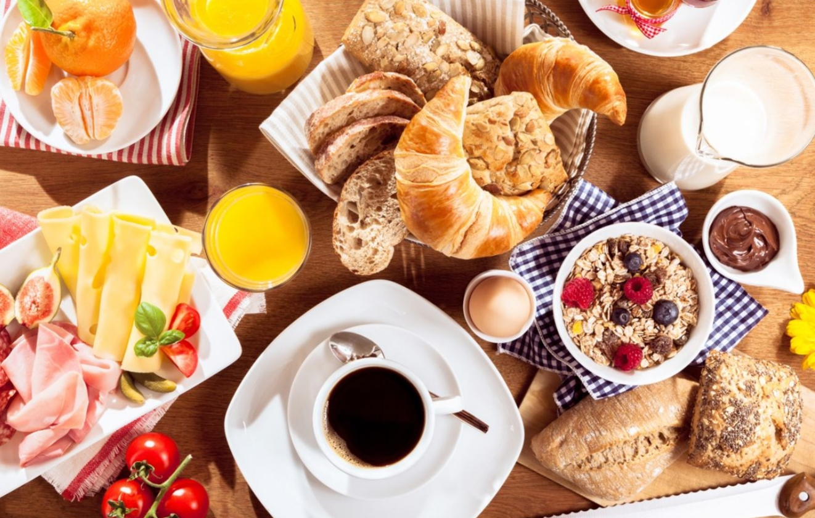
After that, she made a big breakfast for her parents. She made toasted bread, Croissants and Cookies. Her parents were very happy.

Slide 4
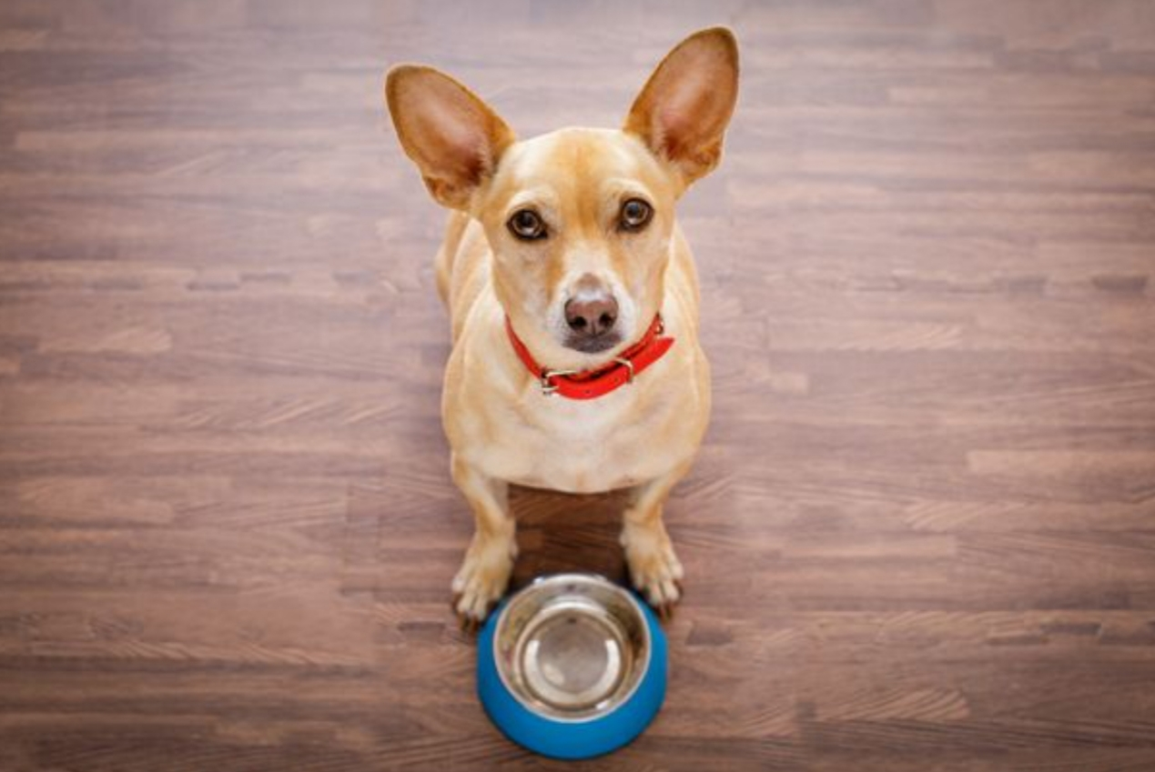
Then it was time to go to school. On her way ,she saw a hungry and really thin dog. She thought he would deserve some food . So, she gave some of her breakfast to the little dog.

Slide 5
As soon as she arrived at school, she entered her classroom feeing happy. She went to play with the other children when she saw her teacher trying to carry too many notebooks. She decided to help her , so she took half of the notebooks and carried them with her to the office.

Slide 6
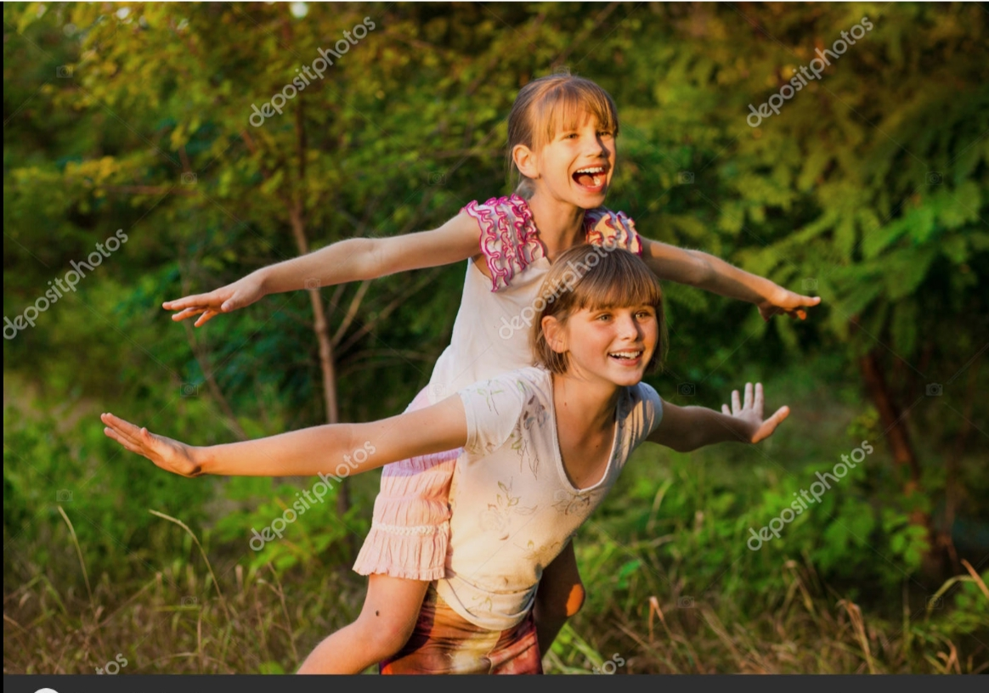
At break time , she saw a little girl sitting alone under a tree. She went near her and asked her why she was sad . The little girl told her “Nobody wants to play with me”. So Ellie, took the girl and went to the class together . She showed all her favourite pens and pencils to the girl and they played together.

Slide 7
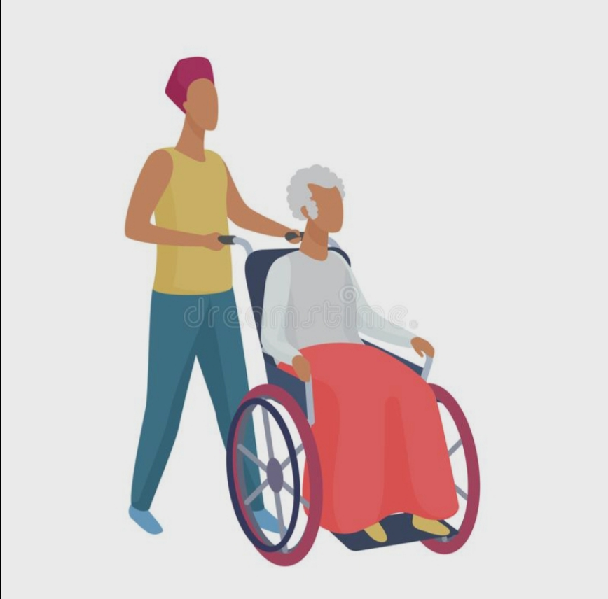
While she was returning from school, Ellie noticed an old lady who was in a wheelchair trying to cross the street. She asked her “Do you want some help?” The lady said “Yes please”. So, Ellie helped the woman to go to the other side of the road.

Slide 8
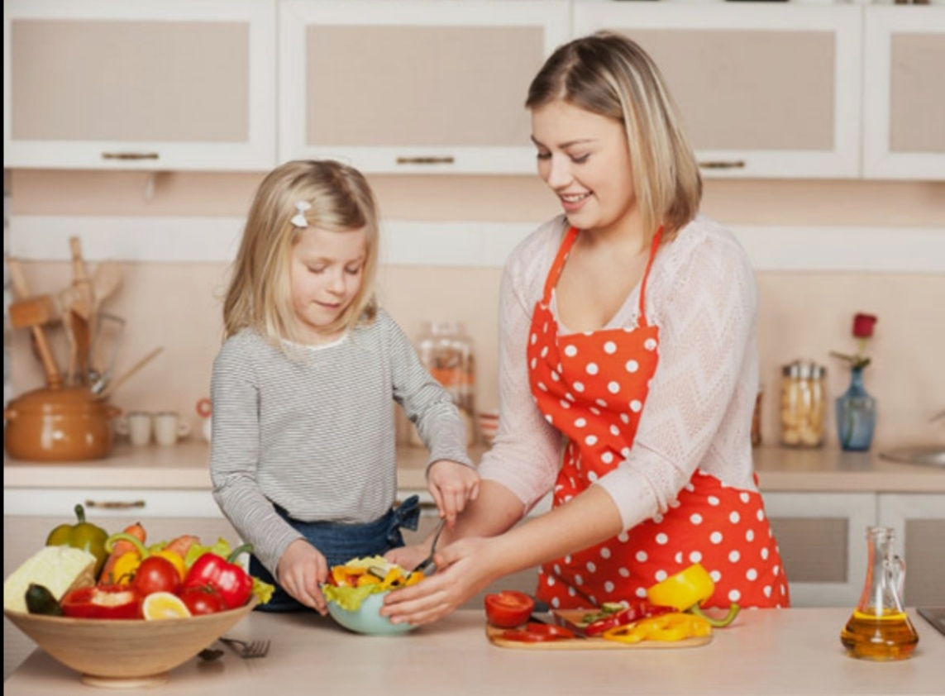
When she finally got home she cleaned her room and she helped her mum cook.

Slide 9
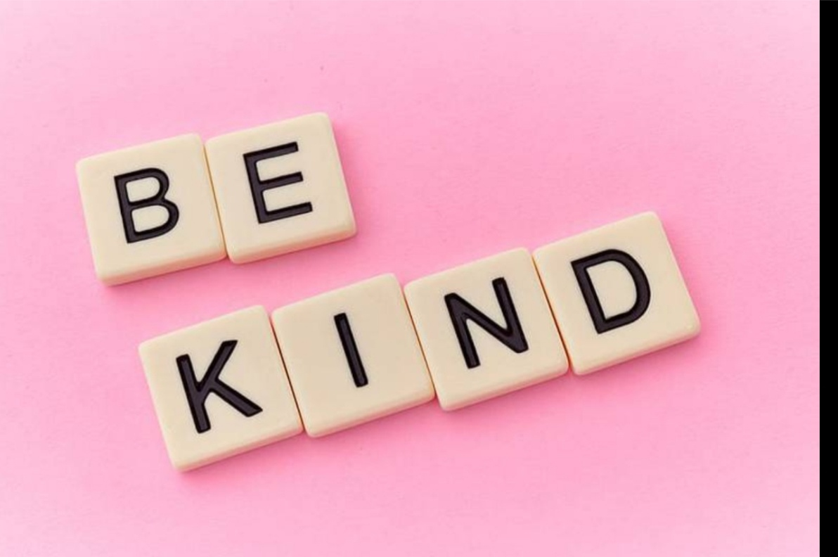
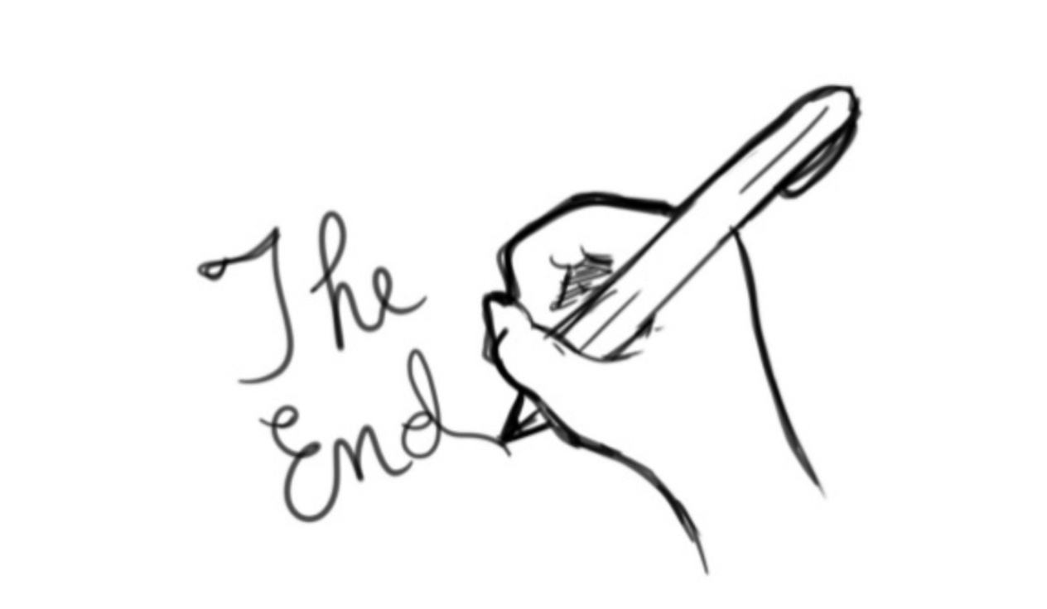
After eating, she went to bed. While she was trying to sleep she was thinking about her day. At first ,she thought that it was a day like all the others. After thinking better, Ellie realised that in the end it was not a day like all the others . It was something else. She had helped many people this day and she was very kind. The words of her mum, “BE KIND” came to her mind again.

