Slide 1
LOVE

Slide 2
Be with others who make you smile

Slide 3
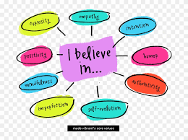
Hold on to your values

Slide 4
Accept the good

Slide 5
Imagine the best

Slide 6
Do things you love

Slide 7
Find purpose

Slide 8
Listen to your heart

Slide 9
Push yourself ,not others

Slide 10
Be open to change

Slide 11
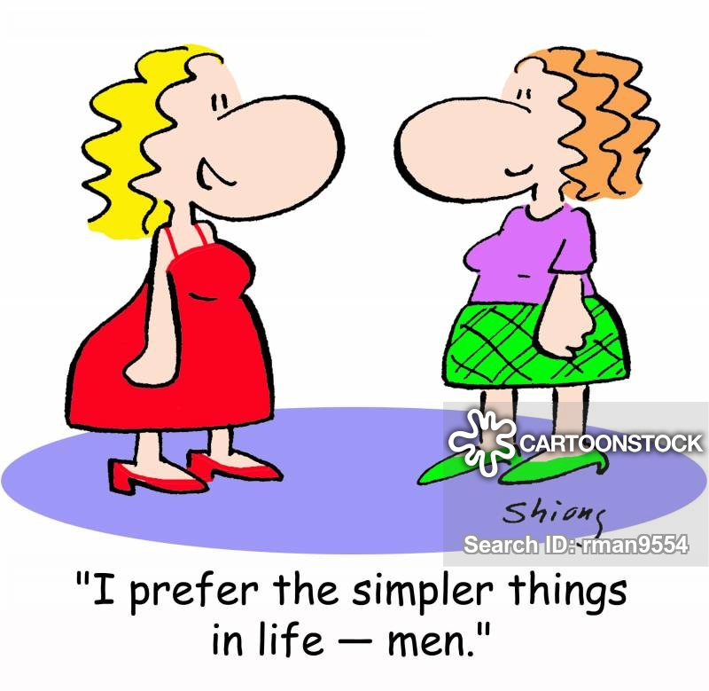
Bask in the simple pleasures

Slide 12
ALEXANDRA

